Slide 1
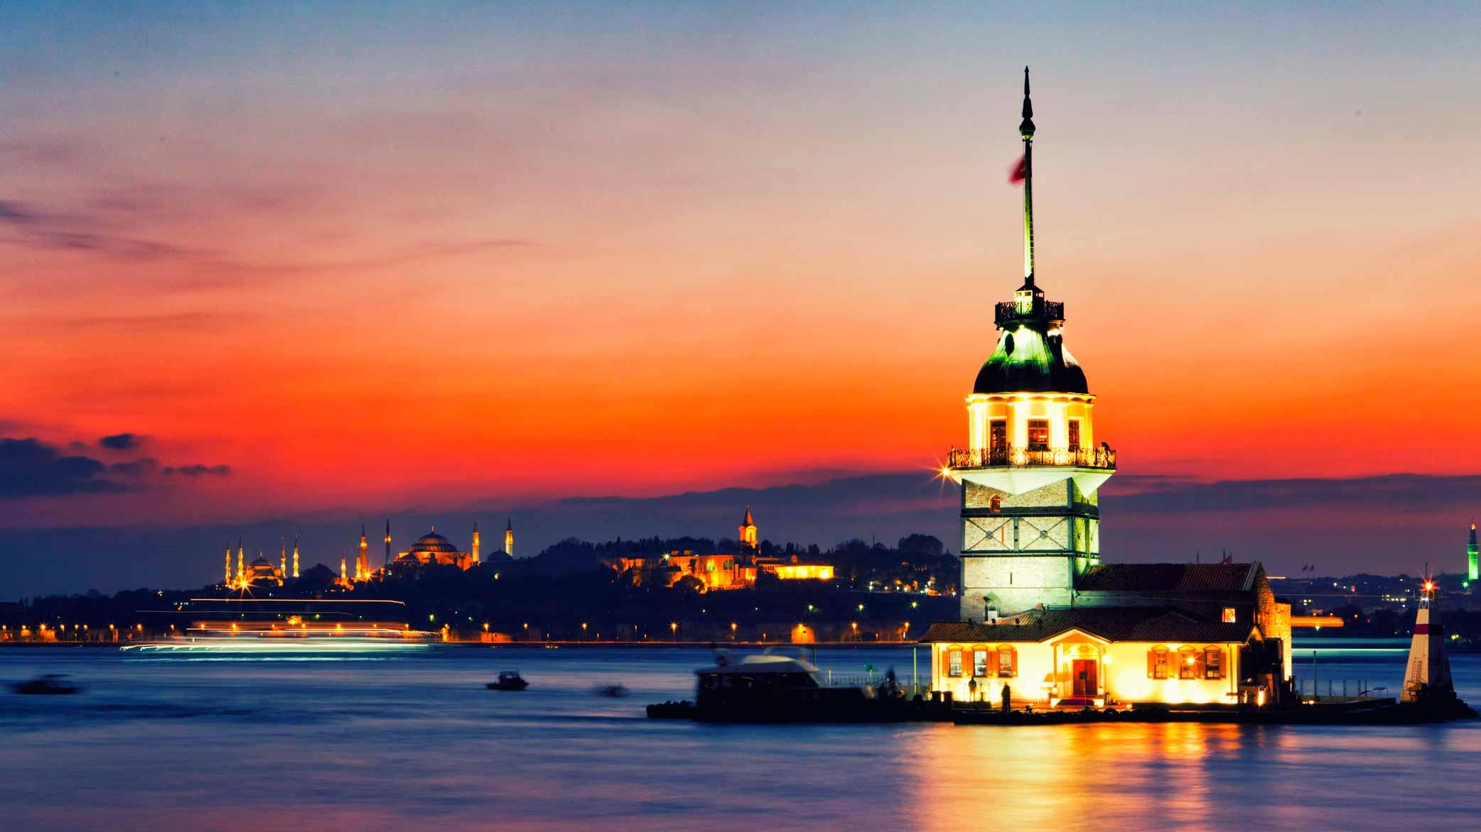
TURKEY
Traditions/Stereotypes/Youth Culture

Slide 2
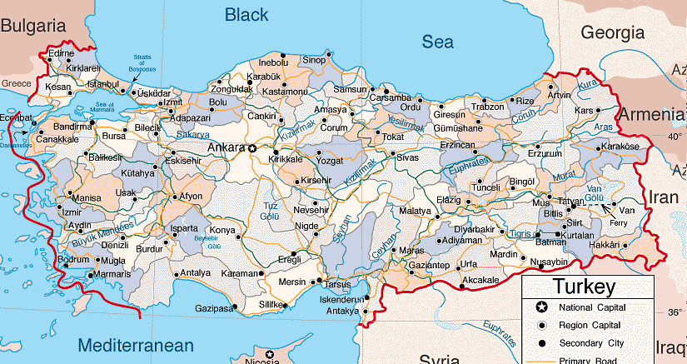
Turkey (Turkish: Türkiye), known officially as the Republic of Turkey, is a Eurasian country located in Western Asia and in East Thrace in Southeastern Europe.
Turkey is bordered by eight countries: Bulgaria to the northwest; Greece to the west; Georgia to the northeast; Armenia, Azerbaijan and Iran to the east; and Iraq and Syria to the southeast.
The majority of the population are Muslims. The country’s official language is Turkish.

Slide 3
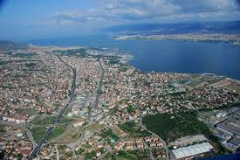
History of Kocaeli (İzmit)
Located in Gulf of İzmit in the Sea of Marmara at west, Black Sea at north
İstanbul at west and Sakarya at east
was the eastern and the most senior capital city of the Roman Empire
Occupied by the UK during Turkish War of Independence
The earthquake of 17 August, 1999, magnitude 7.4, killing more than 19.000 people
Kocaeli University was established in 1992

Slide 4
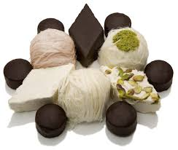
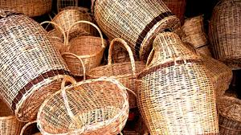
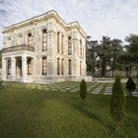
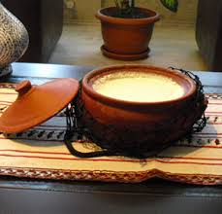
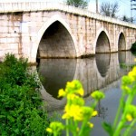
Like a Karamürsel Basket...
(Looking small but being able to do a lot)

Slide 5
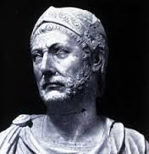
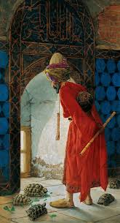
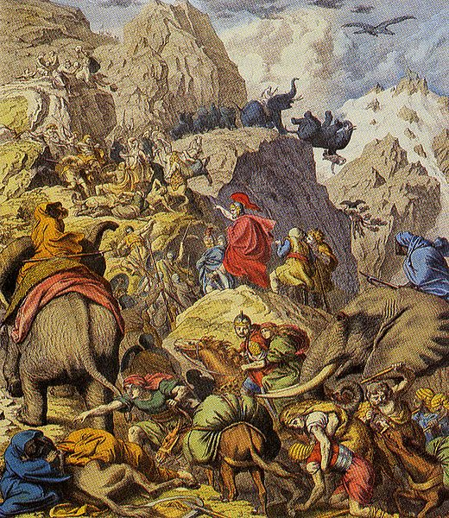
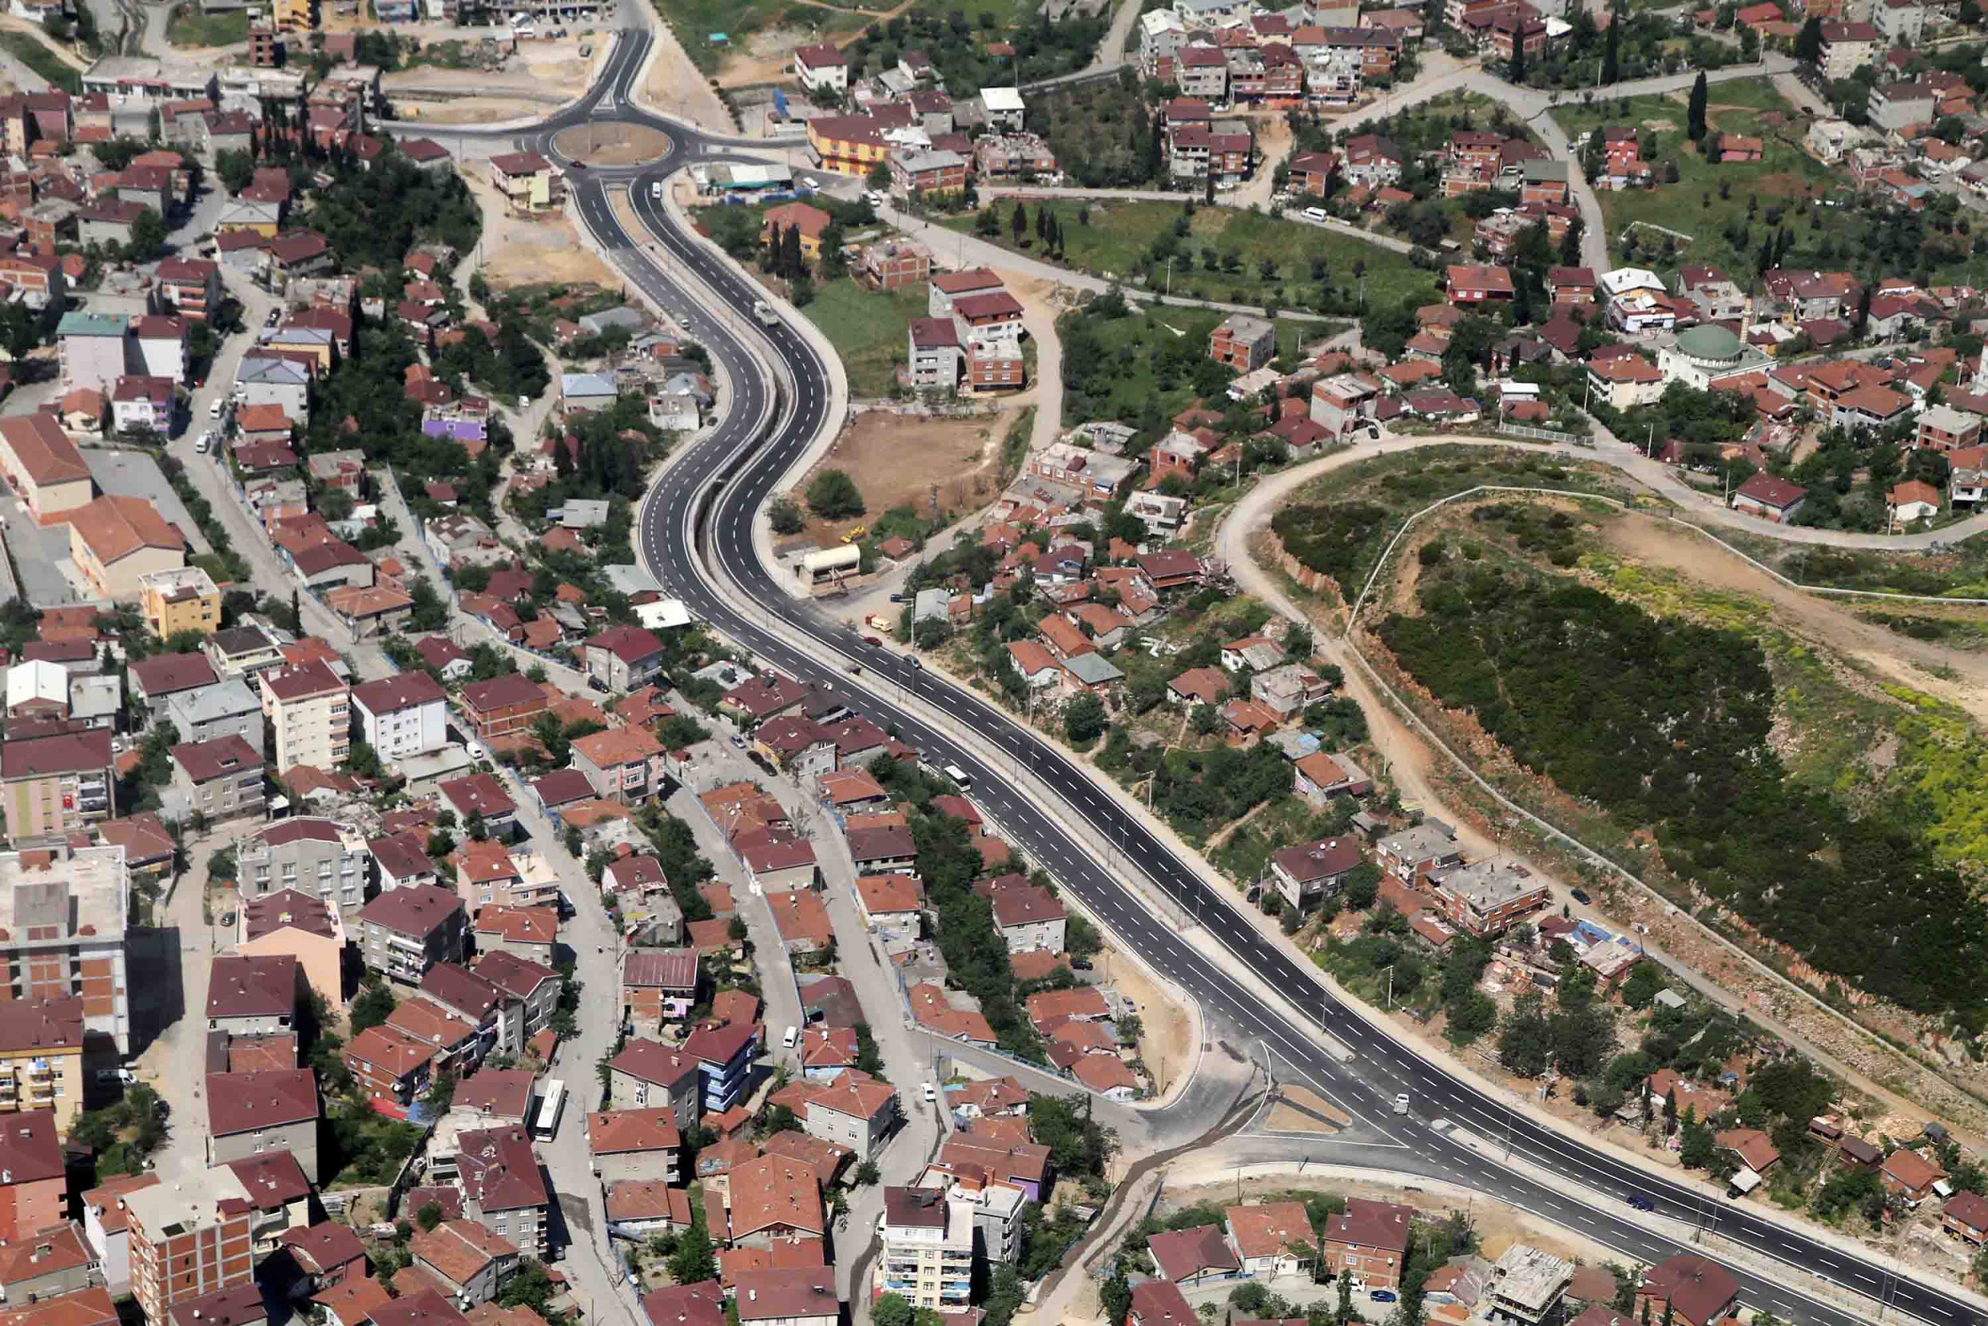
History of Gebze
Phyrgians were here
Industrial town of Kocaeli
Carthagian General Hannibal lost the war against Romans
Committed suicide here
TUBİTAK is located here
House of Osman Hamdi Bey is located here

Slide 6
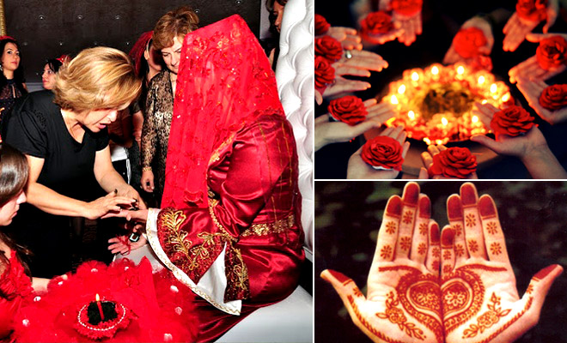
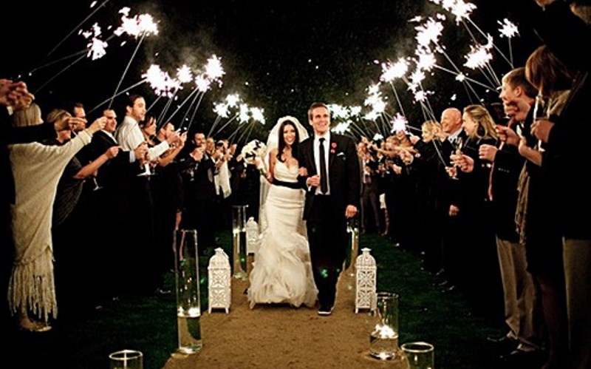
Turkish Customs and Traditions
Turkish Wedding Customs
Age of Marriage: Usually 20-25
In the general procedures of marriage, the groom to be and this family usually take the lead in initiating the steps leading up to marriage, while the courted girl’s family remains passive. The first step toward marriage is expected of the man and his family.

Slide 7
Main Steps of Marriage
Agreement to Marry
Groom’s family goes to bride’s house and asks for her hand.
Engagement
In the traditional sections of the community, women and men sit separated in the bride’s home. In some areas the bridegroom does not come to the bride’s home. In the engagement ceremony on old respected man places engagement rings on bride’s and groom’s fingers with accompaniment of standard words and wishes.
Henna Night
It is a traditional version of the bachelorette party. The night before the wedding, bride spends her last night at her family’s home with the company of women of all ages who are close to the couple’s family. This ceremony get its name from the henna that is being applied on bride’s hands during the night.

Slide 8
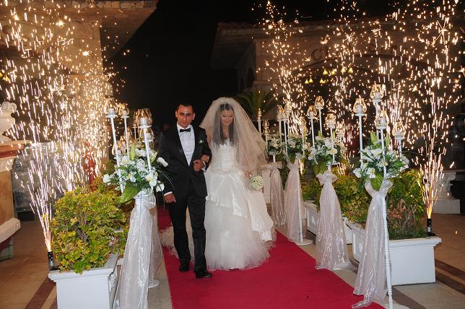
Marriage
First groom’s family go to bride’s house to take her from her home. During this process younger siblings of the bride might receive money or a gift from the groom.
After that guests gather for entertainment. An usual marriage ceremony includes 300-500 guests.

Slide 9
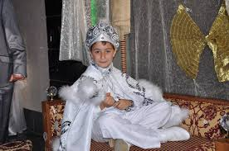
Circumcision Feast
Surgical operation on male sexual organ
back to Ancient Egypt
both religious and traditional
generally in summer at home
as a tradition after the operation the feast is arranged
lots of presents are given to the boy
believed to be healty

Slide 10
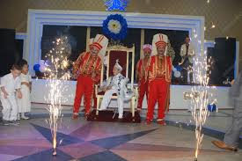
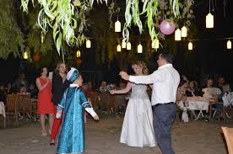
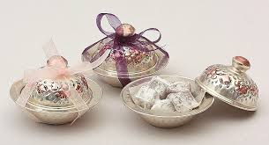

Slide 11
The Turkish Bath
A Turkish bath or hammam is the Turkish variant of the Roman bath, steam bath, sauna, or Russian banya, distinguished by a focus on water, as distinct from ambient steam.
The Turkish bath starts with relaxation in a room (known as the warm room) that is heated by a continuous flow of hot, dry air. Bathers may then move to an even hotter room (known as the hot room) before they wash in cold water. After performing a full body wash and receiving a massage, bathers finally retire to the cooling-room for a period of relaxation.
Traditionally mothers use hammam as a place to find brides for their sons.

Slide 12
Body Language in Turkey
Tutting
When you first meet Turkish, you might spend a lot of time wondering why the Turks are always in a bad mood because Turkish people tut a lot because when Turkish people are tutting, they are infact saying no.
I don’t understand
In the western world, the word “No” is normally accompanied with a shaking of the head from side to side. In Turkey, this means “I don’t understand” so expect someone to repeat themselves if you found yourself shaking your head without realizing it.

Slide 13
Video

Slide 14
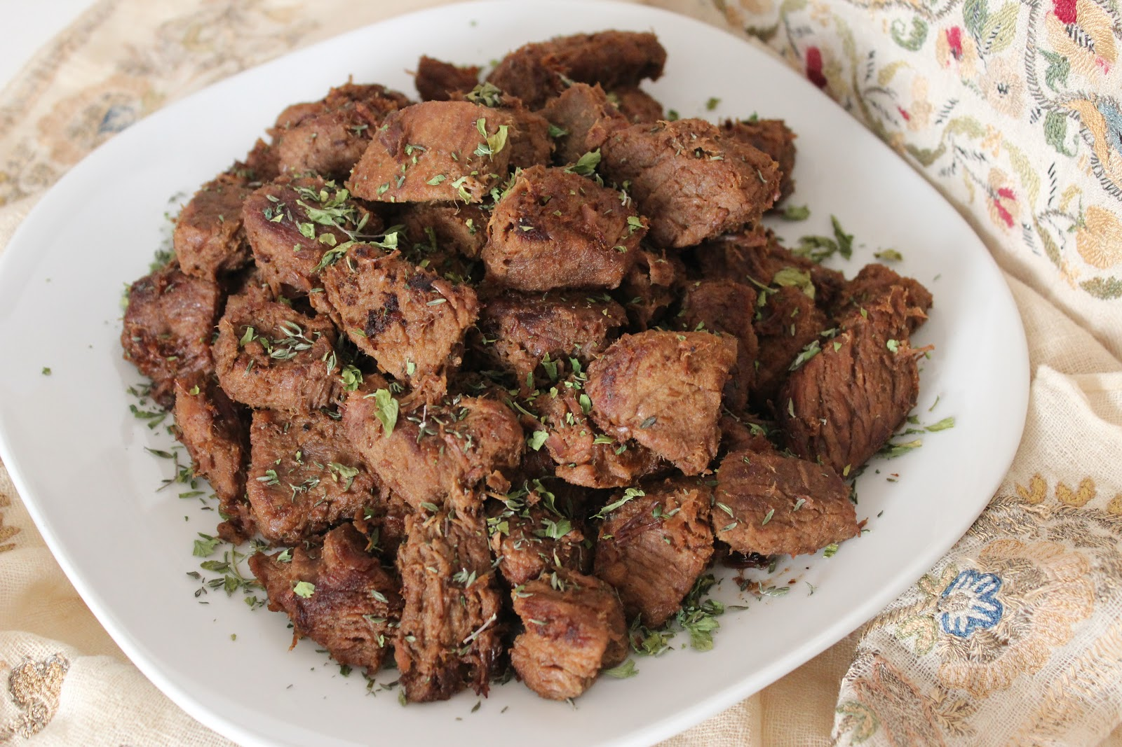
Kurban Bayram (Sacrifice Holiday)
Kurban Bayram in Turkey is known as the Sacrifice holiday and is a major event in the Islamic calendar. The significance relates to the occasion in the Quran when Abraham was ready to sacrifice his own son on the command of God. God interrupted the act and Abraham used a sheep instead however the celebration occurs to show the dedication of Abraham and his acknowledgement that God is everything.
So in sacrifice holiday every family who can afford it sacrifice a farm animal (usually a goat, sheep or cow) and gives most of its meat to the ones who can’t afford it.

Slide 15
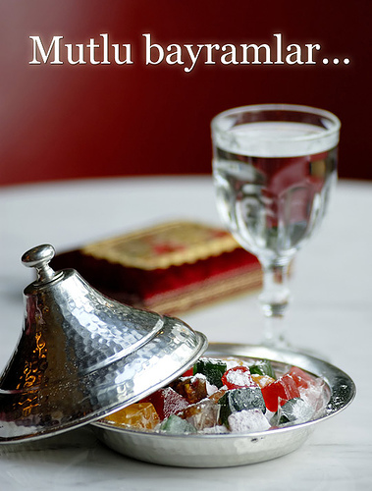
Turkish Bayrams (Festivals)
Ramadan and Ramadan Bayram
Ramadan is a religious period of time that tests the strength, determination and goodwill of Muslim men and women all over the land. Mortal souls that follow the religion of Islam put themselves through the ultimate endurance test by abstaining from food, drink and intimate contact during the hours of daylight.
After 1 month of fasting Ramadan Bayram comes. It lasts 3 days and during those days relatives come together.
Small children knock their neighbor’s doors and ask for candies.

Slide 16
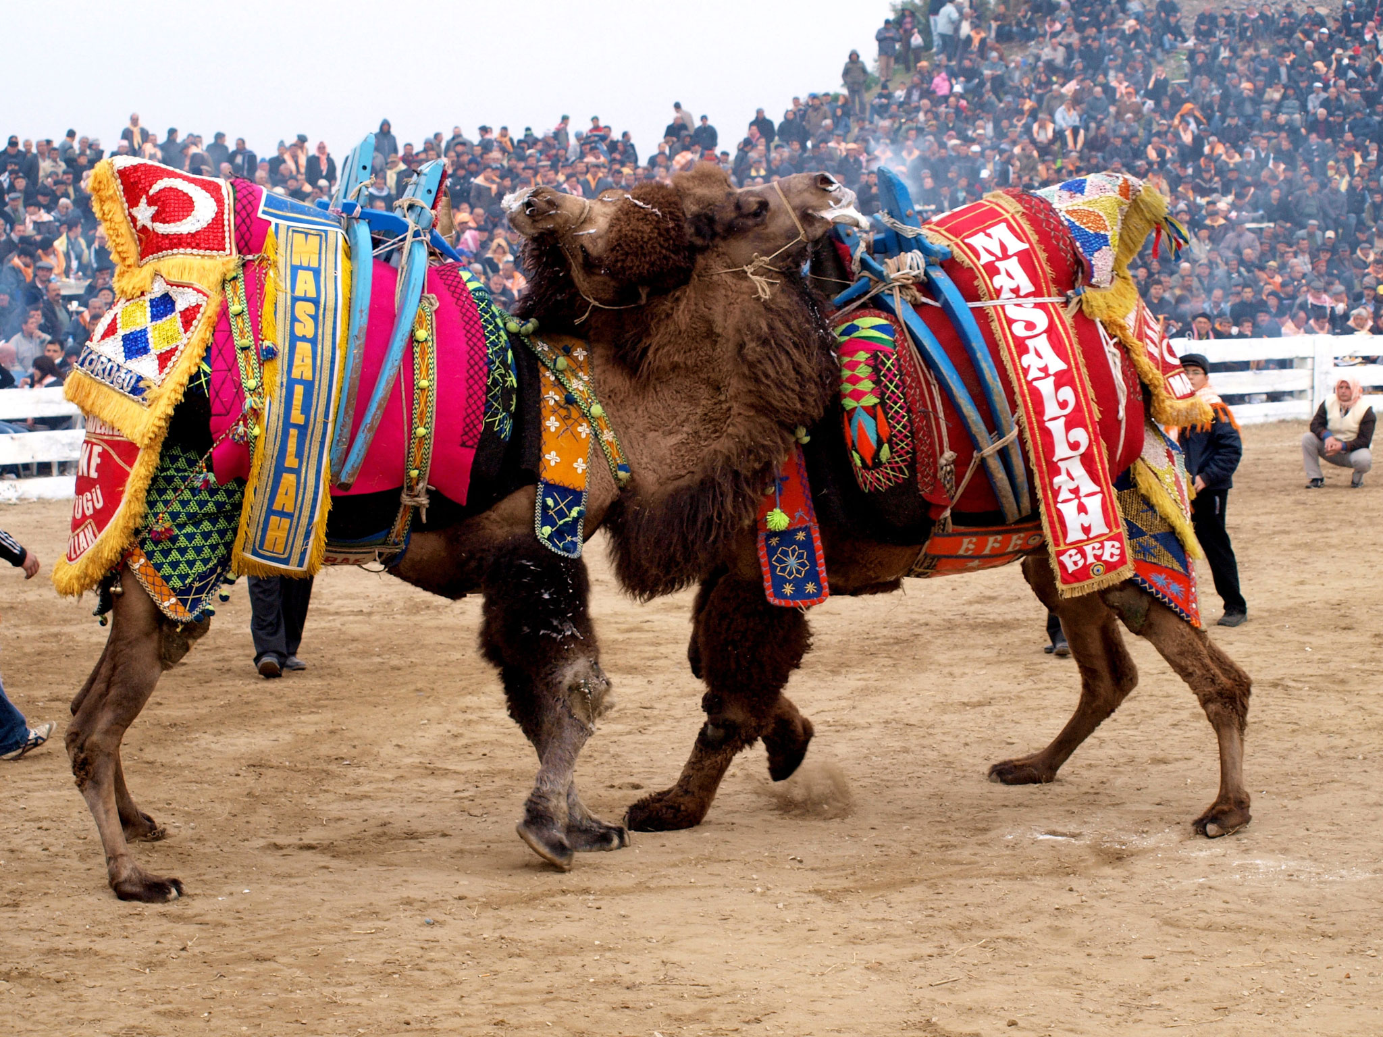
Camel Wrestling
While the Spanish have bullfights, and the Italians cockfights, and the English go hunting with hounds, the Turks have camel wrestling.
Camel wrestling is now mostly restricted to the Aegean region though it was once more widespread in Anatolia.
Wrestling one another would seem to promise some spectacular action.
Camel Wrestling Festivals take this experience and place it in an arena surrounded by people and make this mating ritual a traditional way of entertaining.
Before the wrestling, people usually place bets on which camel they think will win.

Slide 17
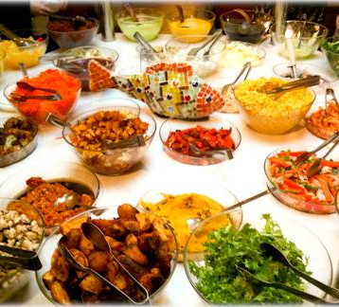
Turkish Food
Turkish cuisine is the heritage of Ottoman cuisine.
It varies across the country.
Lighter use of spices, a preference for rice over bulgur, meatballs and a wider availability of vegetable stews, eggplant, stuffed dolmas and fish.
The cuisine of the Black Sea Region uses fish extensively, especially the Black Sea anchovy (hamsi) and includes maize dishes.
The cuisine of the southeast is famous for its variety of kebabs, mezes and dough-based desserts such as baklava, şöbiyet,kadayıf and künefe.

Slide 18
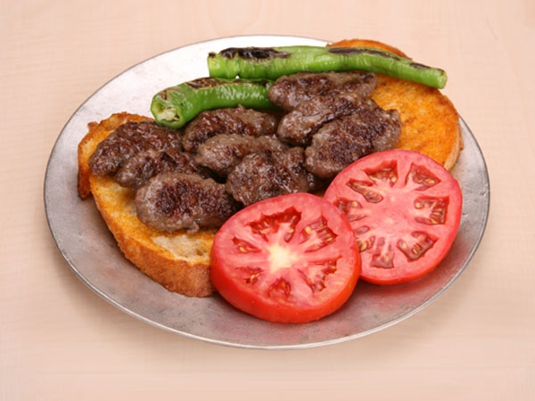
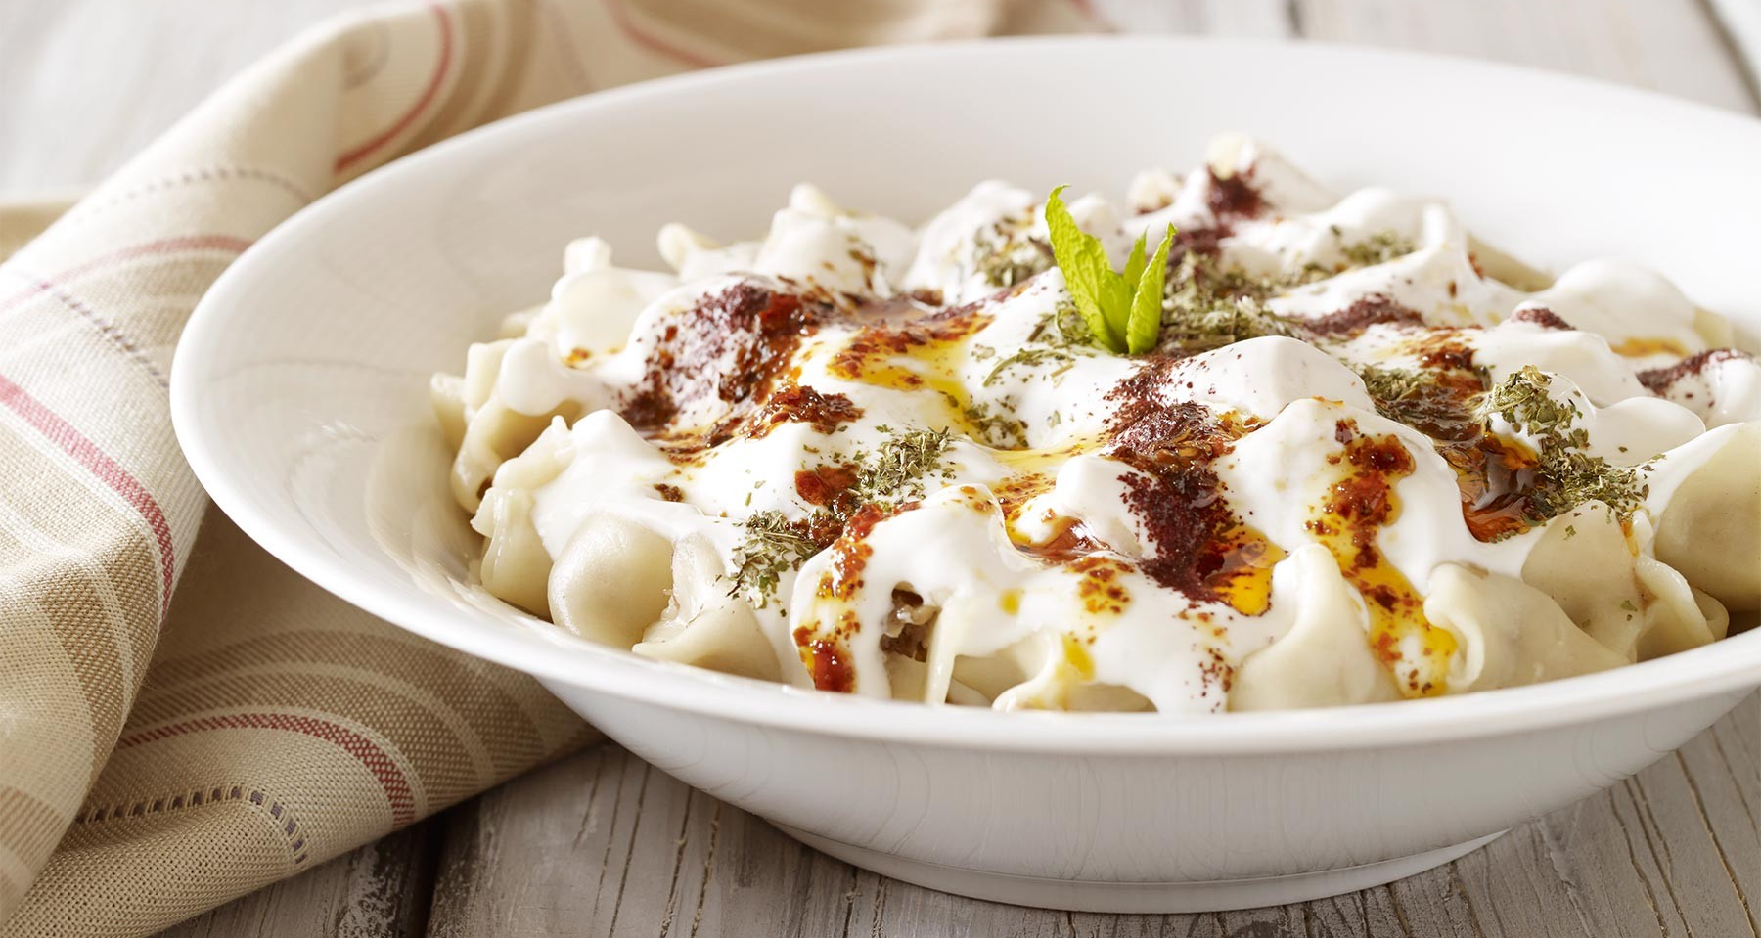
Famous Turkish Dishes
Köfte (Meatball)
A Turkish staple, köfte is balls or patties of ground beef or lamb, and can be served stewed, in sandwiches, over salads, or plain with yogurt. There are 291 different kinds of köfte in Turkey.
Mantı
Mantı might remind you of ravioli at first sight, but the traditional Turkish dish is completely unique in taste and texture. Small beef or lamb dumplings are boiled or fried and served with yogurt or butter, and often accompanied with a range of spices.

Slide 19
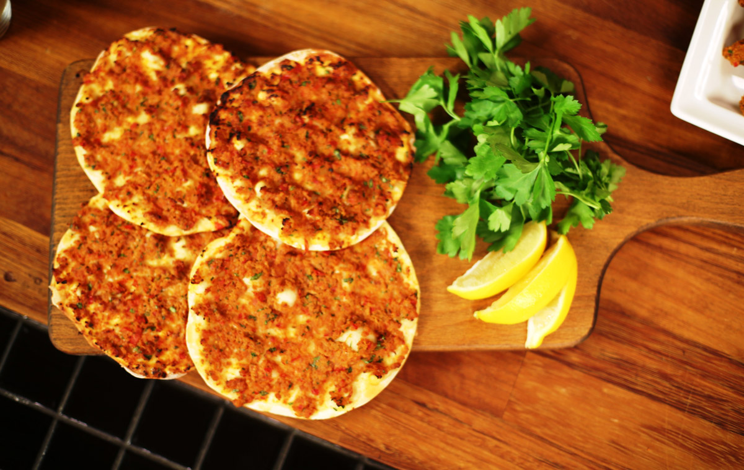
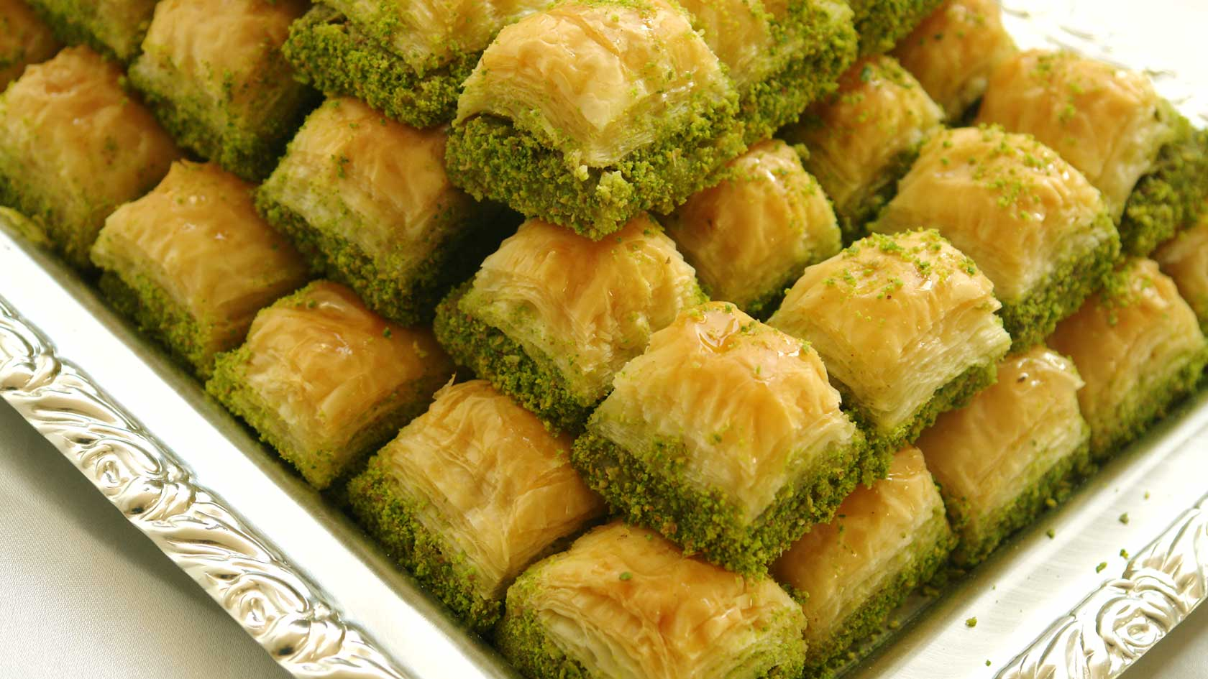
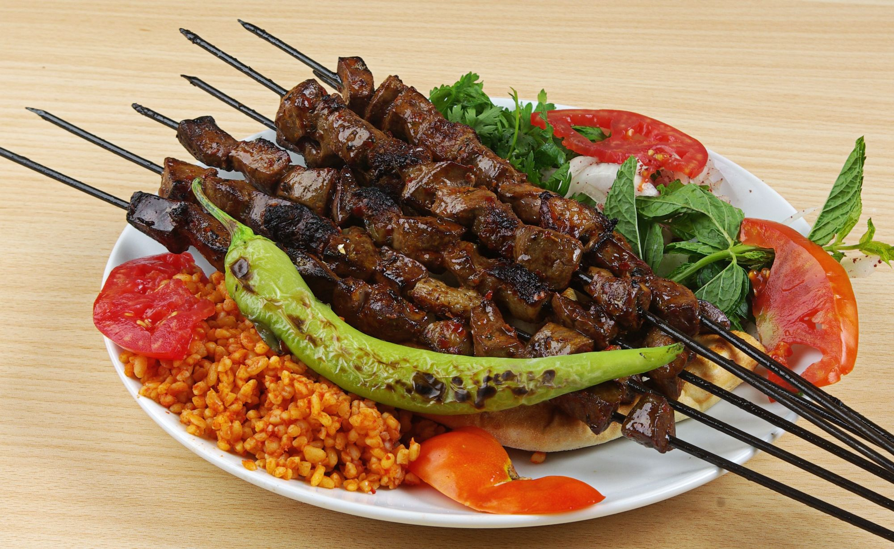
Lahmacun
This flat and crispy bread is traditionally topped with minced meat, salad, and lemon juice, and can be wrapped, folded in half, or pulled apart to eat.
Baklava
Nutty, syrupy, pastry dessert is never better than when served in Turkey. Often topped in ground pistachios, baklava is sweet and unique, and should be eaten fresh!
Şiş Kebap
Meat on a stick originated in Turkey. Sis Kebab is typically lamb, chicken or fish served on a wooden or metal rod, often with bread. Dip it in yogurt or eat it on its own; it’s always tender, savoury, and delicious.

Slide 20
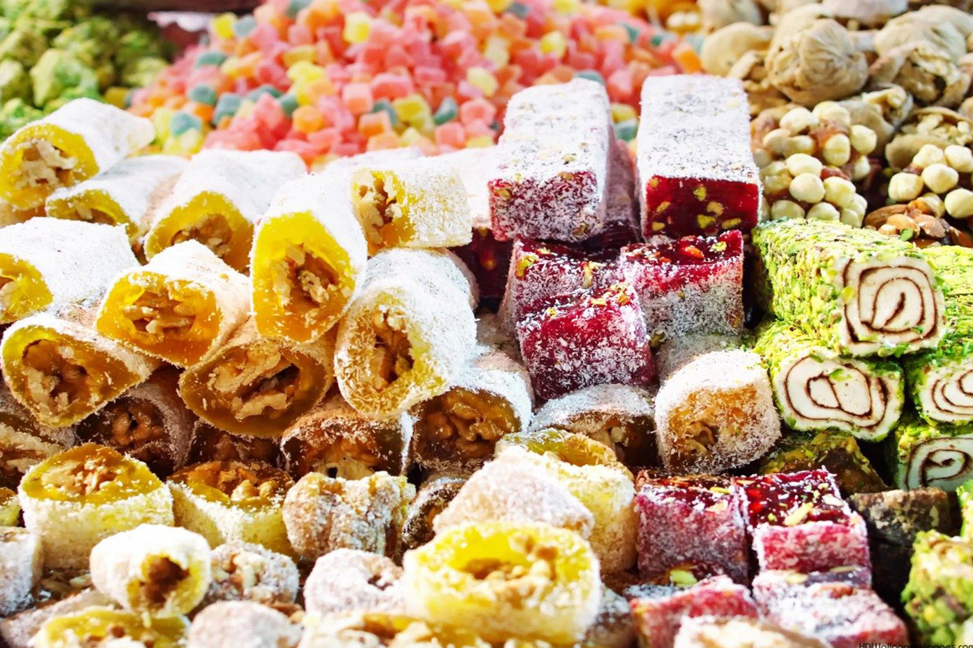
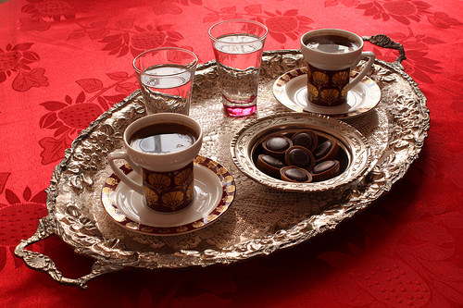
Lokum
Lokum, or Turkish Delight, is a nougaty dessert served with a variety of flavours and fillings and often topped with powdered sugar.
Turkish Coffee
True Turkish coffee is strong, thick, and best served with a fresh piece of Turkish Delight, baklava, or a slice of mozaik cake to take the bitter aftertaste away.

Slide 21
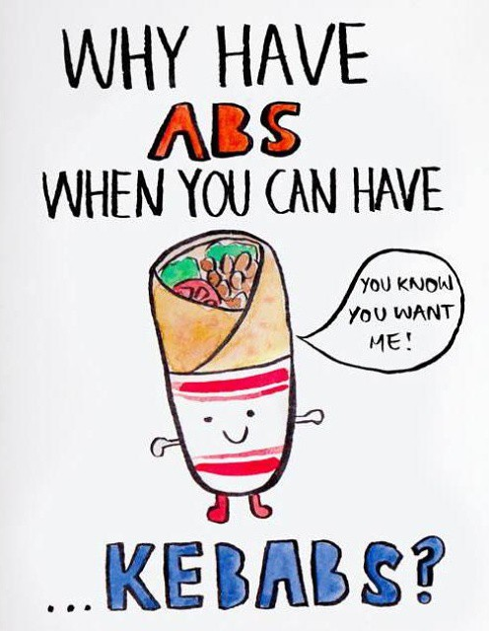
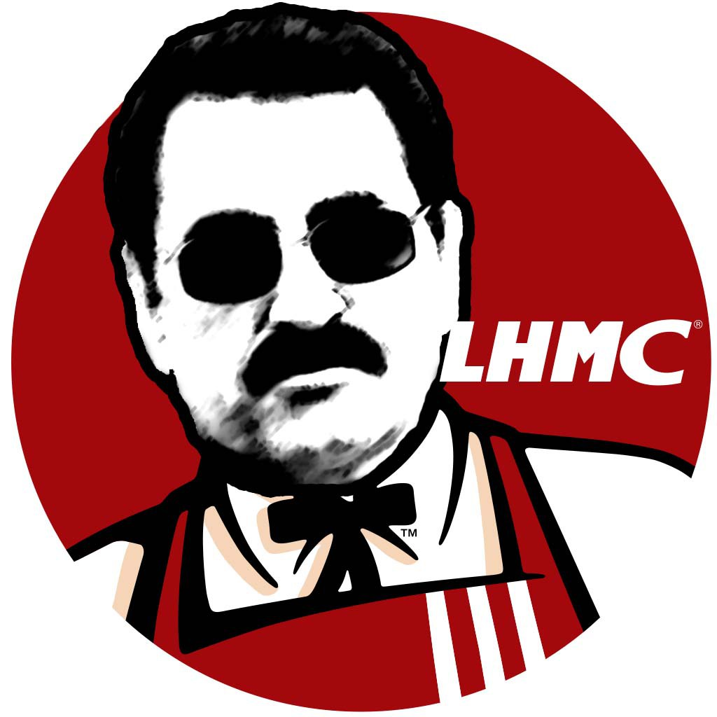
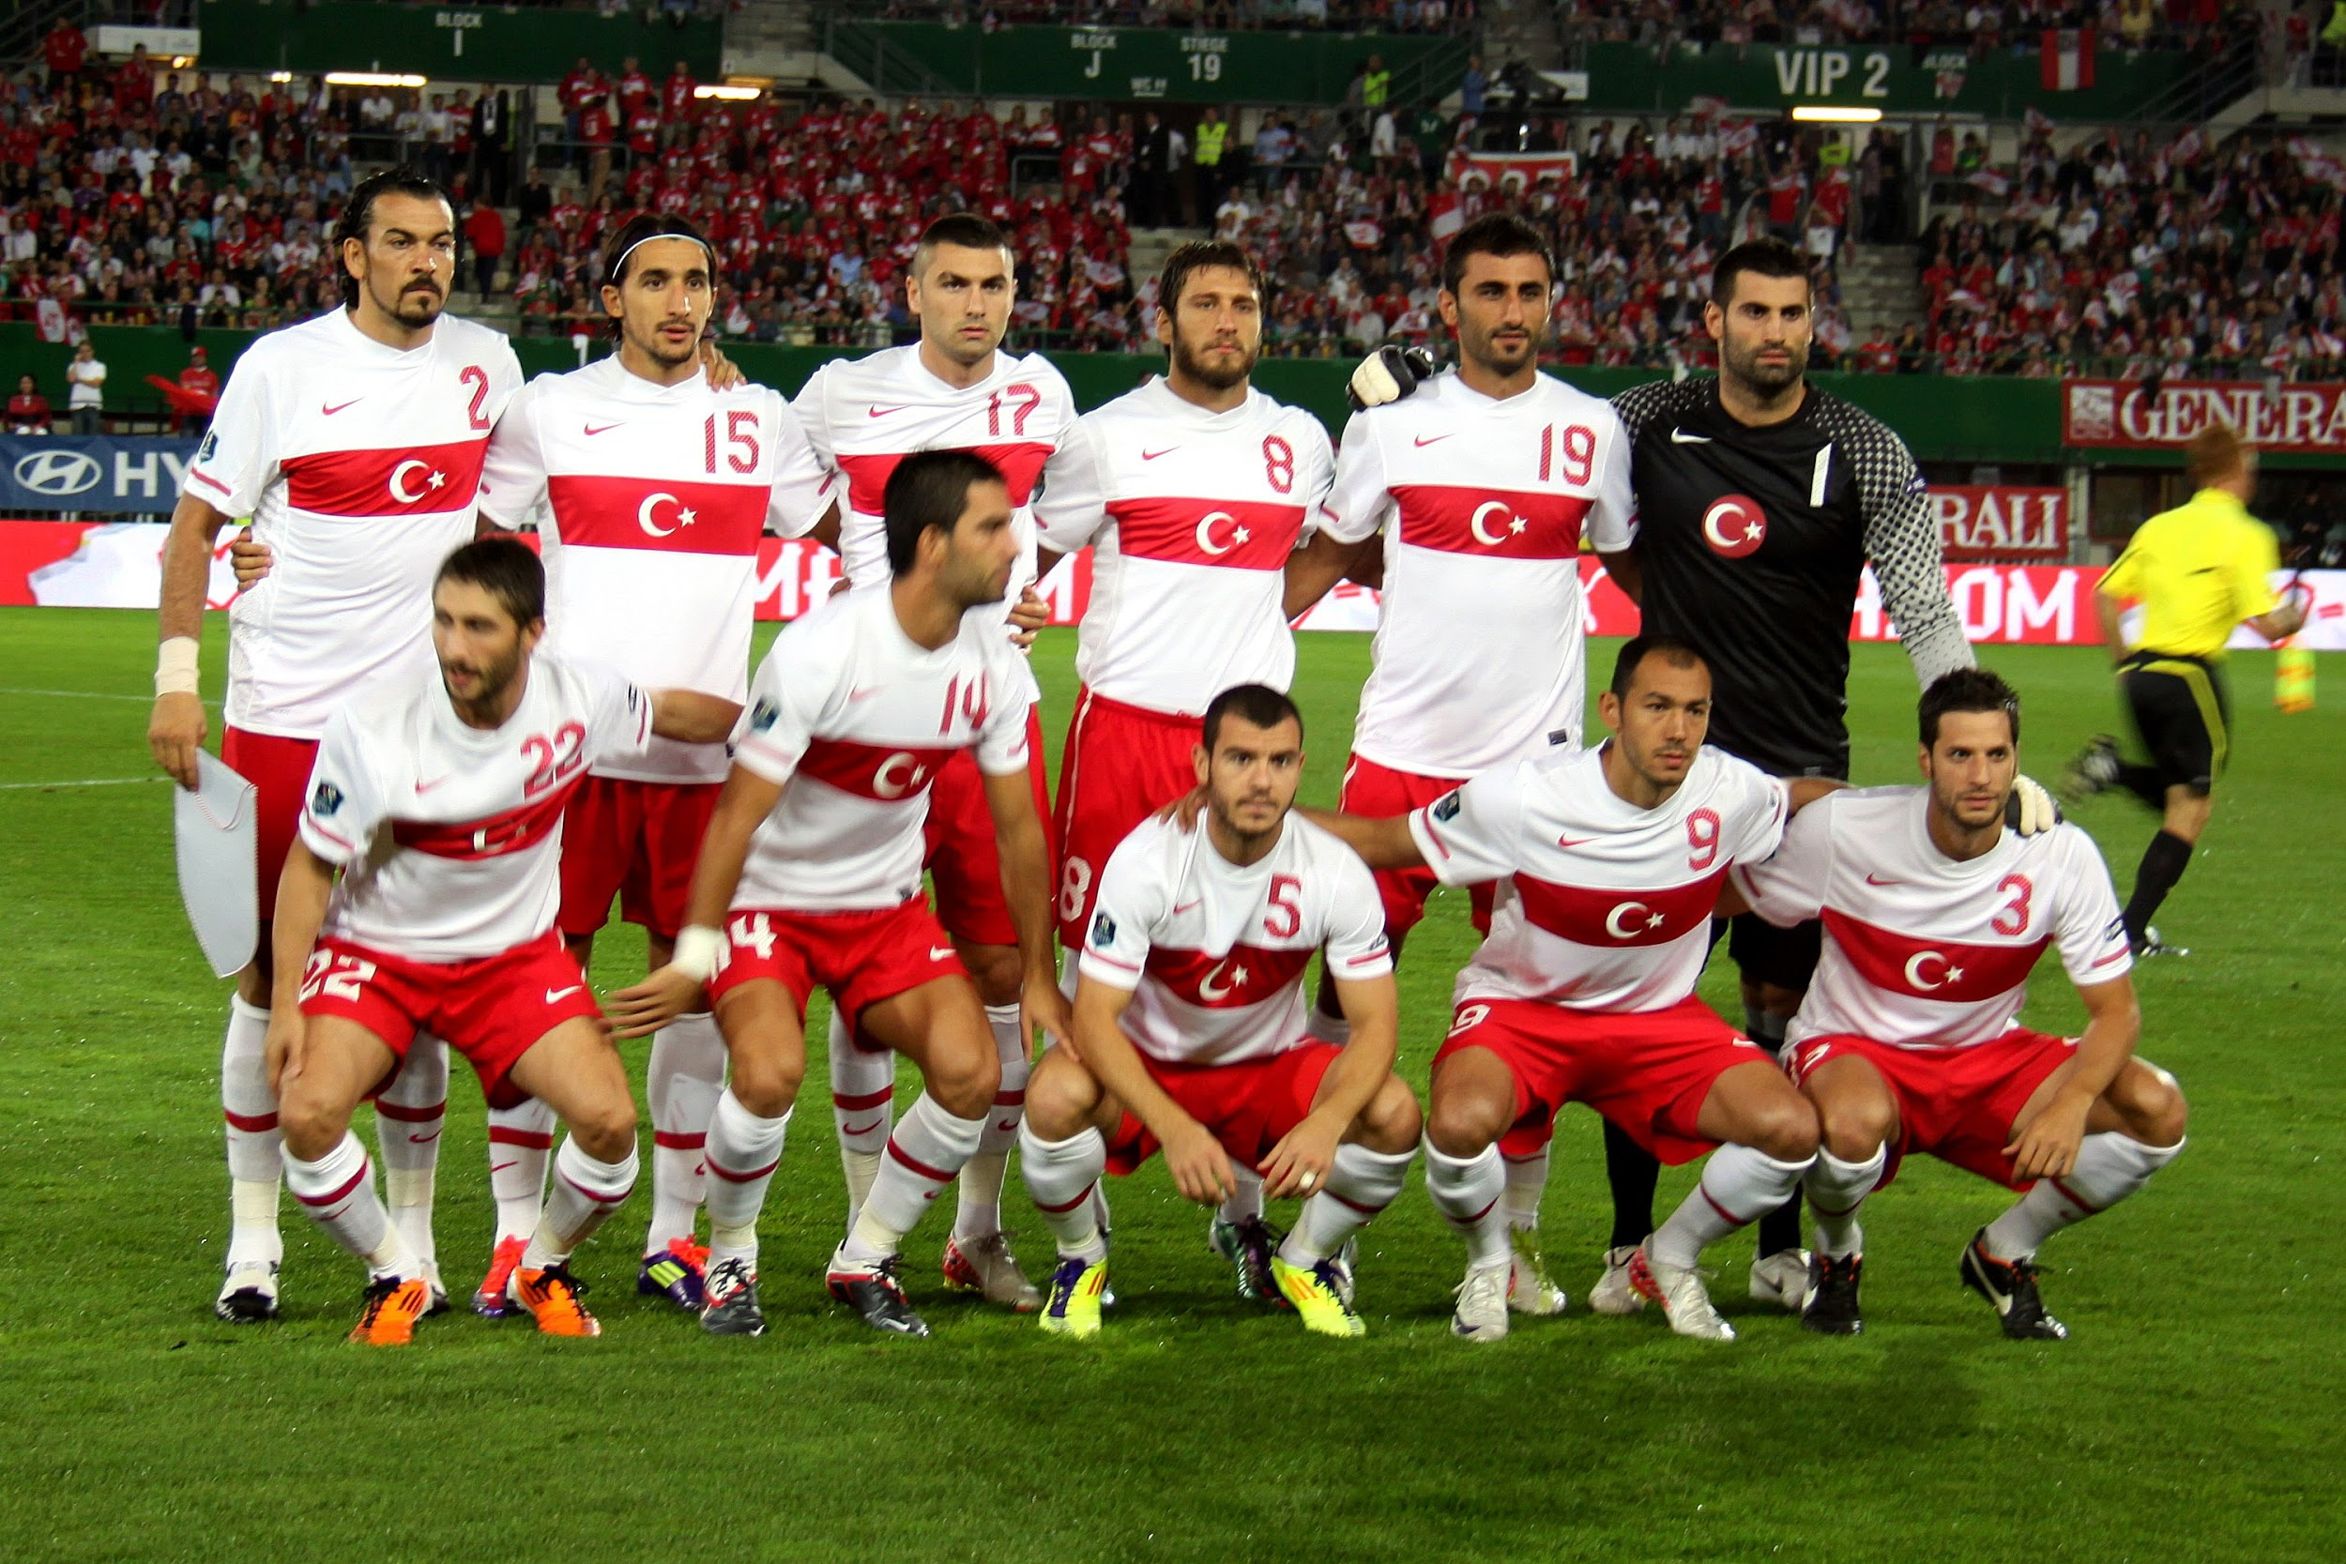
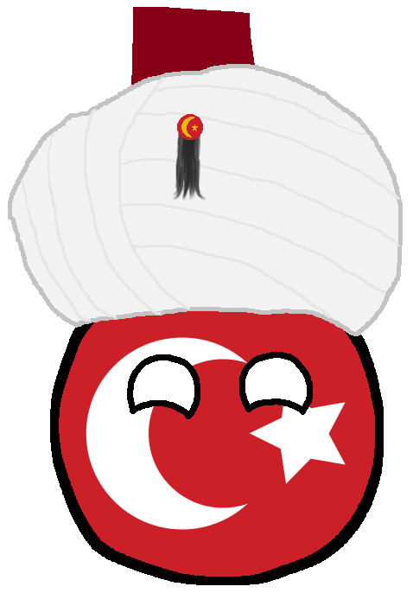
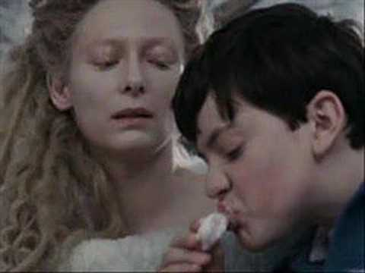
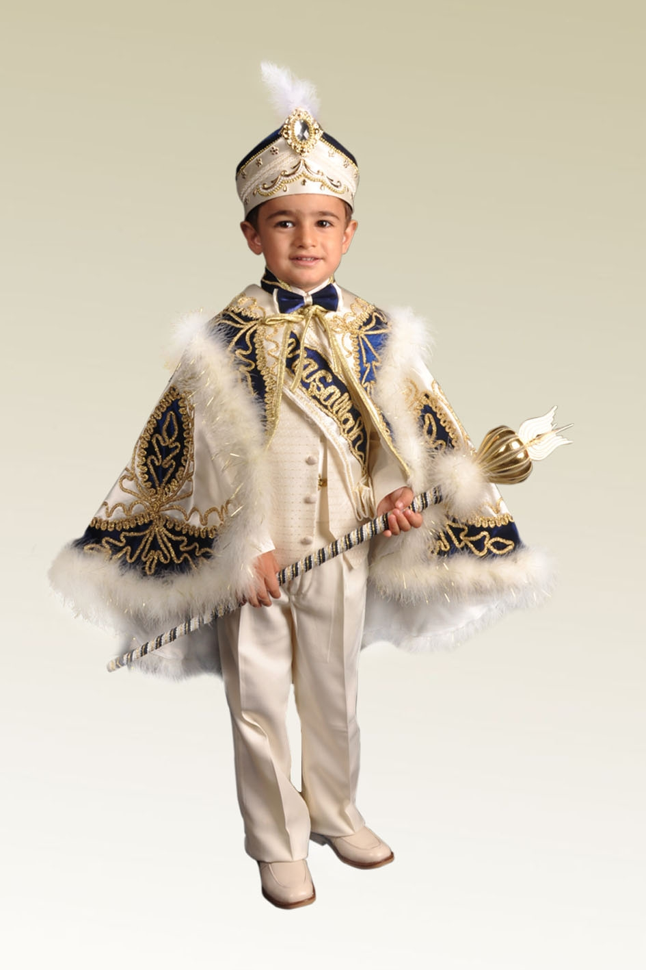
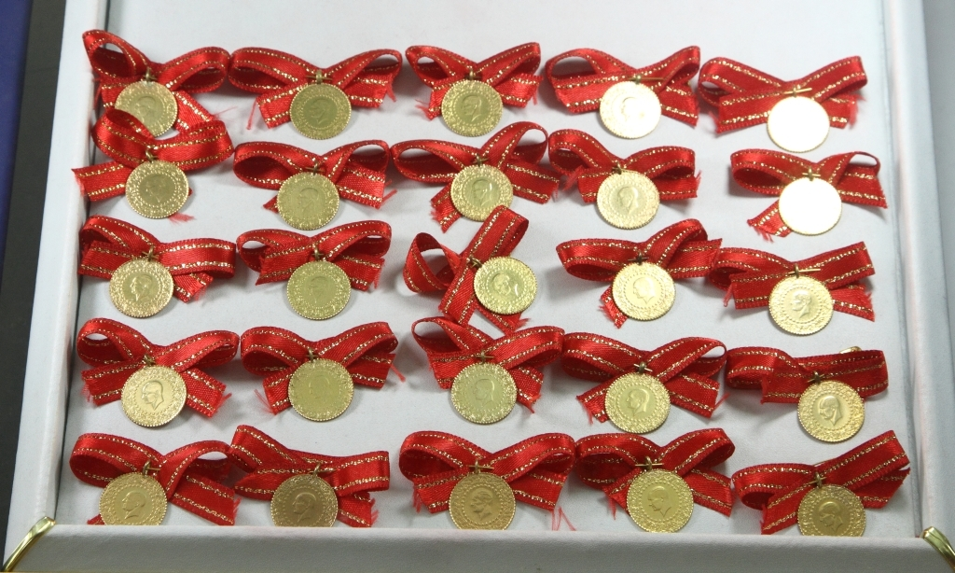
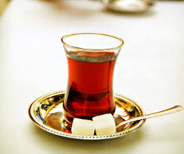
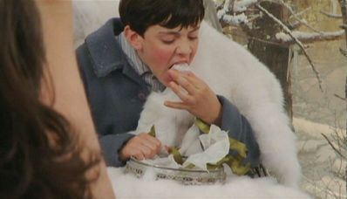
What Makes Us Turkish

Slide 22
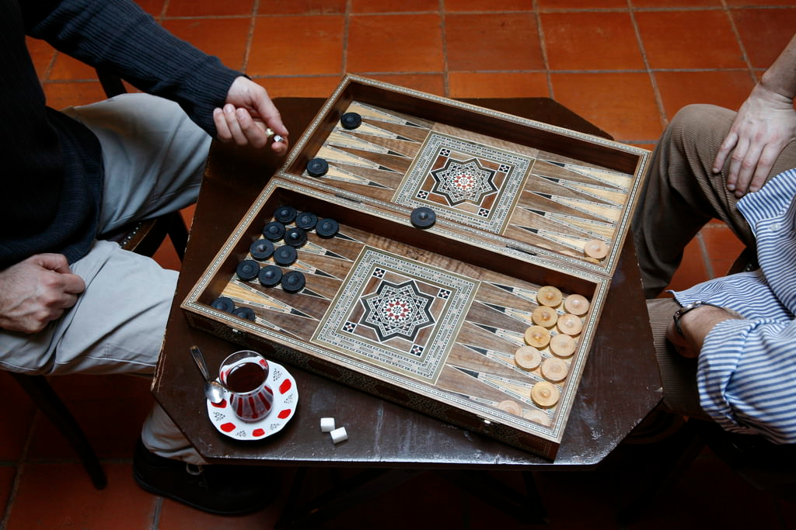
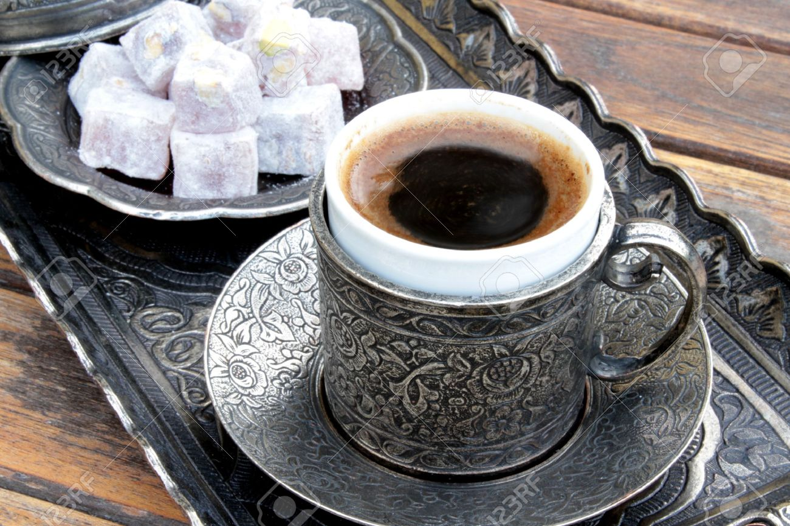
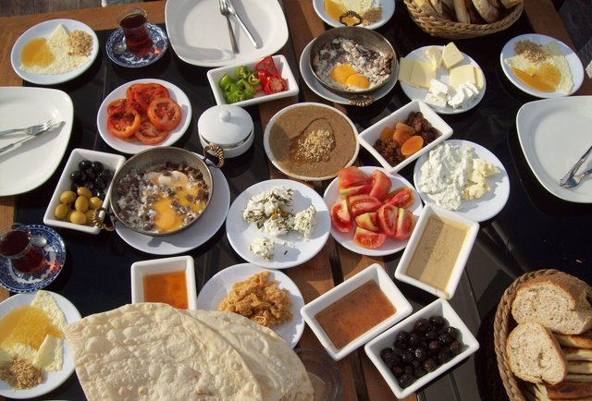
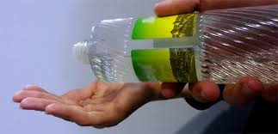
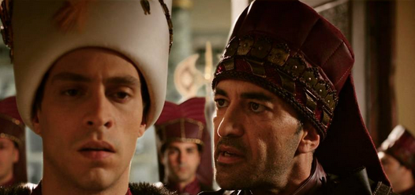
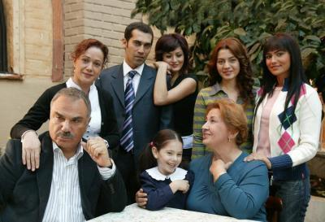
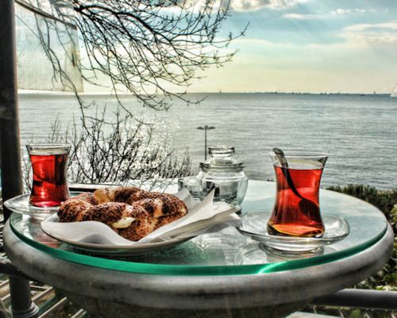
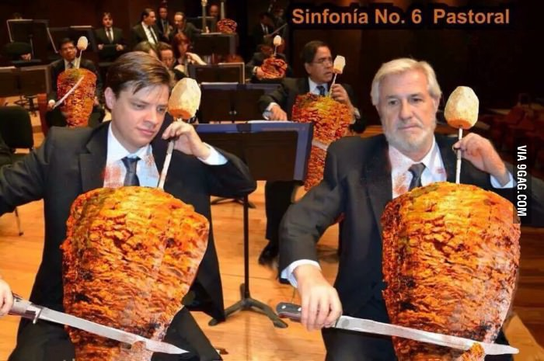

Slide 23
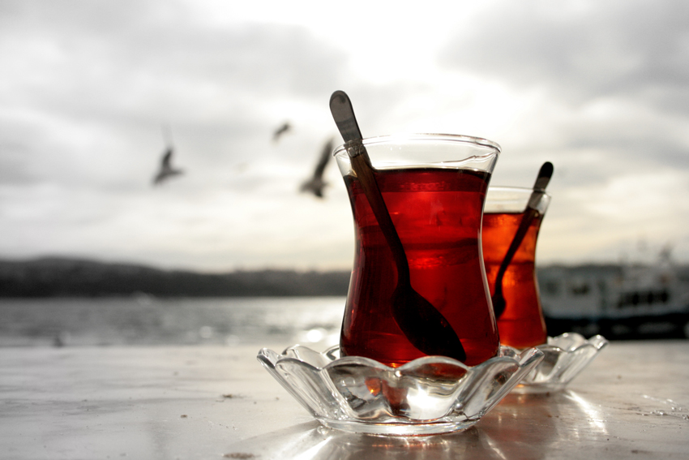
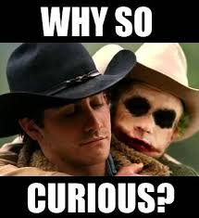
Turkish Stereotypes
We use “very” very frequently
Extreme hospitality
Everyone wears fez and have black hair dark skin and mustache
Speaking arabic
Having desert, camels
Extreme curiosity
Strict Muslim country
Lazy, uneducated
Male dominated families
Having big families
“Çay” tea for all the time
Polygamy (having more than one wife)

Slide 24
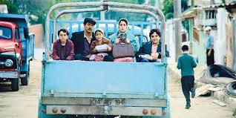

Slide 25
Spanish Streotypes
Tomato fest
Late schedule, being lazy
Dance, being romantic
Everybody knows flamenco
Eating, drinking and partying
Speaking loudly
Soccer is everything
Wine
So much pork
Bullfighting lovers
Dark skin, black eyes, black hair
Religious
Only live in Madrid and Barcelona
English accent
So many bars
Loving free stuff

Slide 26
Turkish Youth Culture
we spend most of our time at school, or at the courses but we are young:

Slide 29
By
Azmi Ozan Ateş
Baran İşcanlı
Barkın Şimşek
Berfin Karaman
Ekin Balcı
Esra Yaman
Ezgi Karayel
Kendal Varolgüneş
Selin Arpacı
Yağmur Ünal

