Slide 1
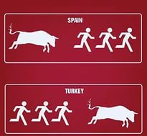
Turkey-Spain similarities
Politics, Economics & History

Slide 2
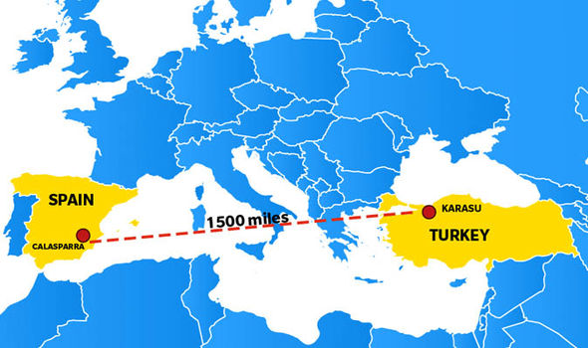
Similarities
Geographic location-mediterranean
Islamic past- 1492 moorish kingdom
Large empires- colonies in latin america and philippines
Agricultural economies
Containing minority nationalisms

Slide 3
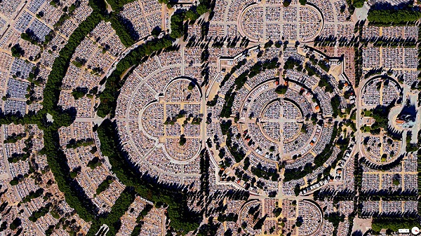
Dispute over small territories, cyprus and north african terrirories and Gibraltar
Migration from town to city
Exported workers to europe
Tourism is an important income in both
During crisis, unstable election results- terror attack in madrid→ worker’s party

Slide 4
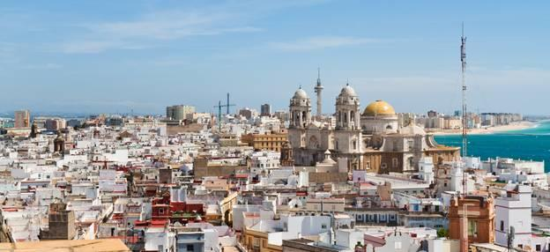
History
Holy league a coalation of spain venice and papacy,
Defeats Ottoman Turks
In Lepanto, Greece
Spain and Turkey. Spain has an embassy in Ankara and a consulate general in Istanbul. Turkey has an embassy in Madrid and a consulate general in Barcelona.

Slide 5
Economy
€
₺
Excluding the EU, Turkey is Spain’s third most important trade partner after the US and Mexico
26.3 vs. 9.3 rate of unemployement
Gdp per capita 15.300 vs. 30.100
The largest project involving Spanish companies is the recently completed high-speed train line between Ankara and Eskisehir(245km).
In 2008, more than 350,000 Spanish tourists visited Turkey.

Slide 6
Politics
Parlamentary democracy vs parlemantary monarch
Spain is one of the major countries supporting Turkey’s membership to the European Union.
There are approximately 40,000 Turks in Spain.

Slide 7
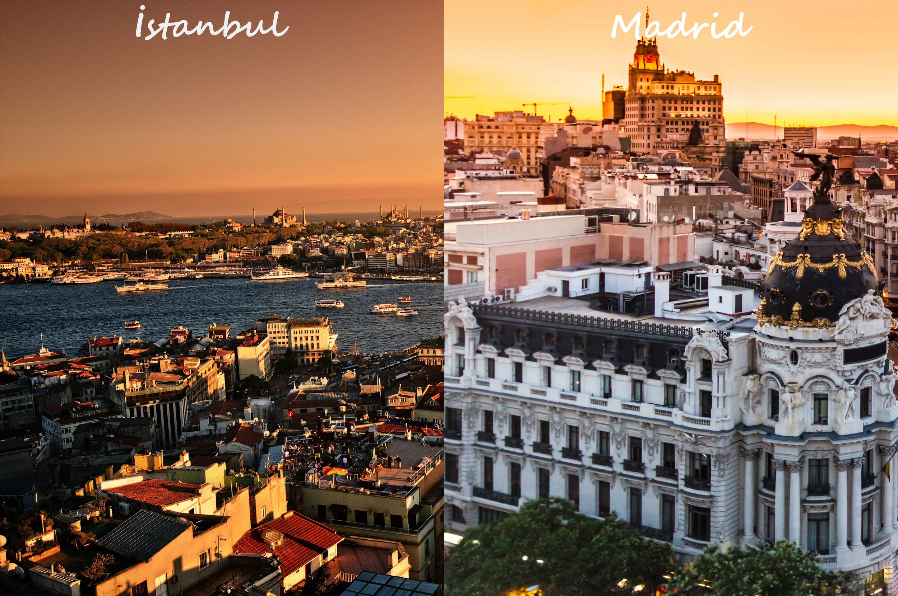
https://expatexplorer.hsbc.com/survey/country/spain/turkey

