Slide 1
Byzantium Heritages
Constantinople (330-1204 AD; 1261-1453 AD)

Slide 2
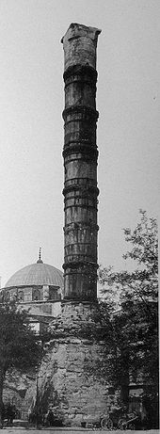
Column of Constantine
The column was dedicated on May 11, 330 AD, with a mix of Christian and pagan ceremonies.
The center of the Forum of Constantine
An oval forum situated outside the city walls in the vicinity of what may have been the west gate of Antoninia
50 meters tall, constructed of several cylindrical porphyry blocks
These blocks were surmounted by a statue of Constantine in the figure of Apollo
The orb he carried was said to contain a fragment of the True Cross.

Slide 3
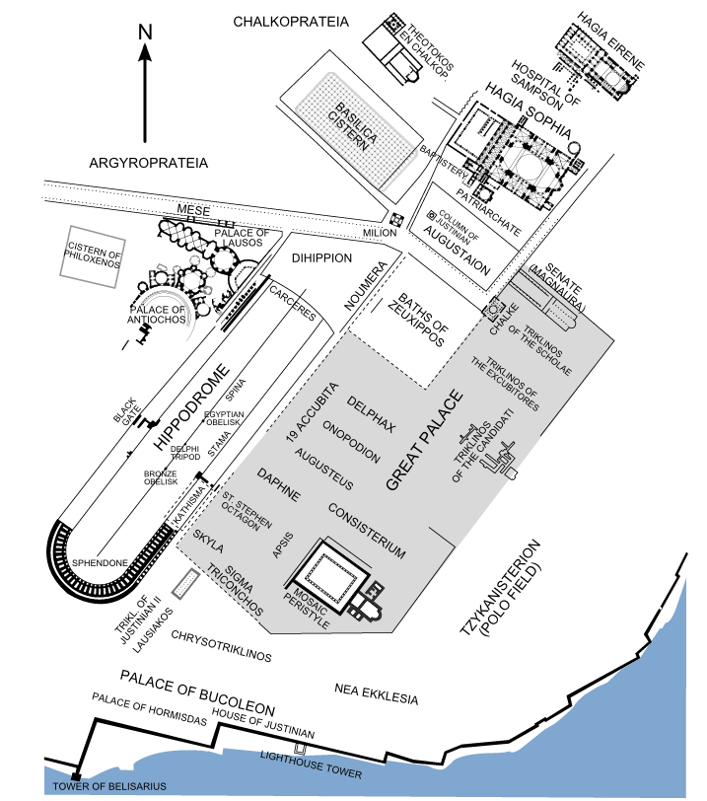
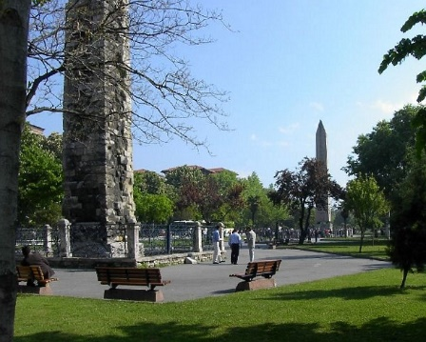
Hippodrome of Constantinople
Horse racing and chariot racing were popular pastimes in the ancient world and hippodromes were common features of Greek cities in the Hellenistic, Roman and Byzantine eras.

Slide 4
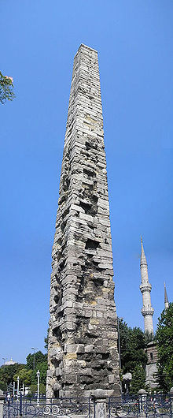
Walled Obelisk
Situated near the Serpentine Column at the southern side of the Hippodrome of Constantinople (now Sultanahmet Square) in Istanbul, Turkey. Its original construction date is unknown, but it is named after Constantine VII, who repaired it in the tenth century.

Slide 5
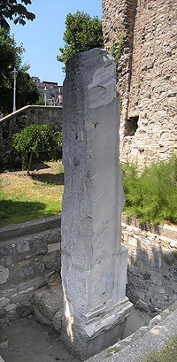
Milion
(Greek: Μίλιον or Μίλλιον, Míllion; Turkish: Milyon taşı)
was a monument erected in the early 4th century AD in Constantinople (modern-day Istanbul, Turkey). It was the Byzantine zero-mile marker, the starting-place for the measurement of distances for all the roads leading to the cities of the Byzantine Empire
Same function as the Golden Milestone (Milliarium Aureum) in Rome's forum
The domed building of the Milion rested on four large arches, and it was expanded and decorated with several statues and paintings.
Had disappeared by the start of the 16th century

Slide 6
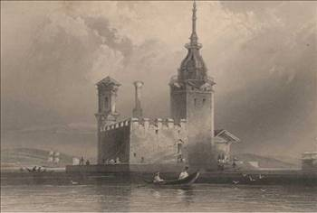
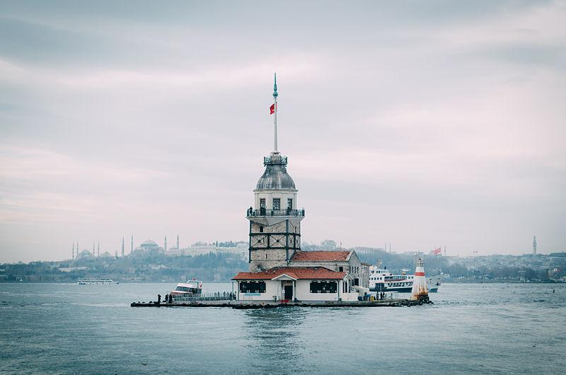
Maiden's Tower
(Turkish: Kız Kulesi)
Also known as Leander's Tower (Tower of Leandros) since the medieval Byzantine period, is a tower lying on a small islet located at the southern entrance of the Bosporus strait 200 m (220 yd.) from the coast of Üsküdar in Istanbul, Turkey.

Slide 7
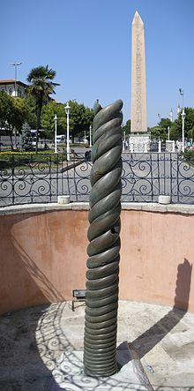
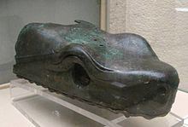
Serpent Column
Also known as the Delphi Tripod, or Plataean Tripod,
Ancient bronze column at the Hippodrome of Constantinople
It is part of an ancient Greek sacrificial tripod, originally in Delphi and relocated to Constantinople by Constantine I the Great in 324
It was built to commemorate the Greeks who fought and defeated the Persian Empire at the Battle of Plataea (479 BC). The serpent heads of the 8-metre (26 ft) high column remained intact until the end of the 17th century

Slide 8
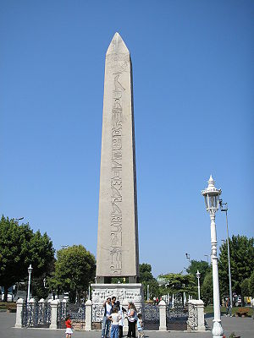
Obelisk of Theodosius
Was first set up by Thutmose III (1479–1425 BC)
To the south of the seventh pylon of the great temple of Karnak
The Roman emperor Constantius II (337–361 AD) had it and another obelisk transported along the river Nile to Alexandria to commemorate his ventennalia or 20 years on the throne in 357. The other obelisk was erected on the spina of the Circus Maximus in Rome in the autumn of that year, and is today known as the Lateran obelisk, whilst the obelisk that would become the obelisk of Theodosius remained in Alexandria until 390, when Theodosius I (379–395 AD) had it transported to Constantinople and put up on the spina of the Hippodrome there.

Slide 10
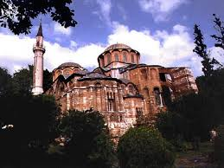
Atik Mustafa Pasha Mosque
(Turkish: Atik Mustafa Paşa Camii; also named Hazreti Cabir Camii)
Is a former Eastern Orthodoxchurch in Istanbul, converted into a mosque by the Ottomans
The dedication of the church is obscure
For several years called as Saints Peter and Mark
Identified with Saint Thekla of the Palace of Blachernae (Greek: Άγία Θέκλα τοῦ Παλατίου τῶν Βλαχερνών, Hagia Thekla tou Palatiou tōn Vlakhernōn)
The building belongs stylistically to the eleventh-twelfth century.

Slide 11
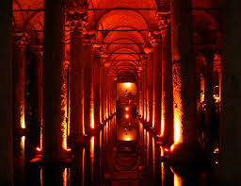
Basilica Cistern
The largest of several hundred ancient cisterns that lie beneath the city of Istanbul (formerly Constantinople), Turkey
The cistern, located 500 feet (150 m) southwest of the Hagia Sophia on the historical peninsula of Sarayburnu, was built in the 6th century during the reign of Byzantine Emperor Justinian I

Slide 12
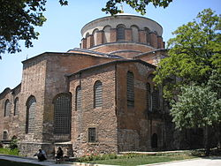
Hagia Irene
Site of a pre-Christian temple
The first church built in Constantinople
Roman emperor Constantine I commissioned the first Hagia Irene church in the 4th century
Served as church of the Patriarchate before Hagia Sophia was completed in 360.
First Council of Constantinople took place in the church.
Burned down and restored in 548, earthquake in 8th century,
Interior decorated with mosaics and frescoes
Hagia Irene is the only example of a Byzantine church in the city which retains its original atrium
The church measures 100 m × 32 m
Typical form of a Roman basilica
Consisting of a nave and two aisles, divided by columns and pillars. It comprises a main space, anarthex, galleries and an atrium. The dome is 15m wide and 35m high and has twenty windows.

Slide 13
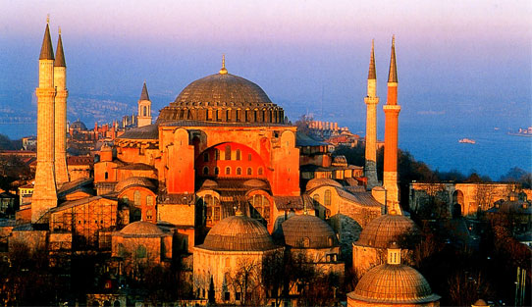
Hagia Sophia
Former Greek Orthodox Christian patriarchal basilica (church)
Later an imperial mosque
Museum (Ayasofya Müzesi) in Istanbul, Turkey.
From the date of its construction in 537 until 1453, it served as an Orthodox cathedral and seat of the Patriarch of Constantinople, except between 1204 and 1261, when it was converted to a Roman Catholic cathedral under the Latin Empire. The building was a mosque from 29 May 1453 until 1931. It was then secularized and opened as a museum on 1 February 1935.

Slide 14
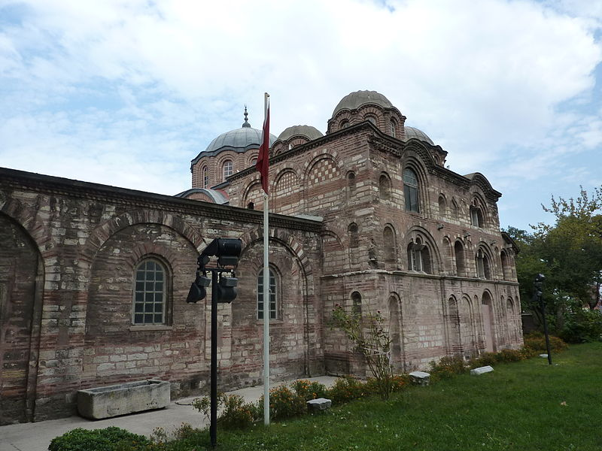
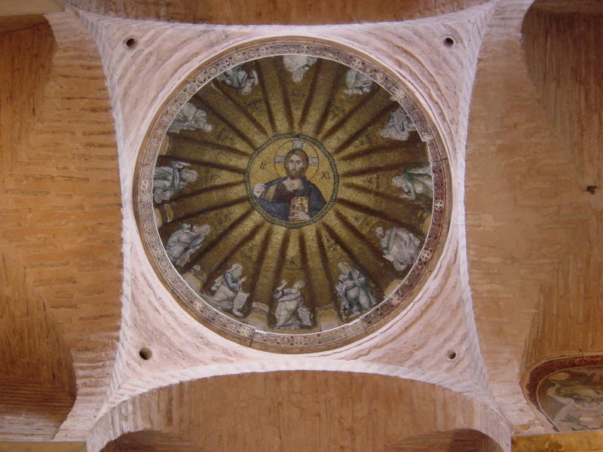
Pammakaristos Church
Church of Theotokos Pammakaristos (Greek: Θεοτόκος ἡ Παμμακάριστος, "All-Blessed Mother of God"),
In 1591 converted into a mosque and known as Fethiye Mosque (Turkish: Fethiye Camii, "mosque of the conquest")
Partly a museum, is one of the most famous Greek Orthodox Byzantine churches
One of the most important examples of Constantinople's Palaiologan architecture, and the last pre-Ottoman building to house the Ecumenical Patriarchate
The largest amount of Byzantine mosaics in Istanbul after the Hagia Sophia and Chora Church.

Slide 15
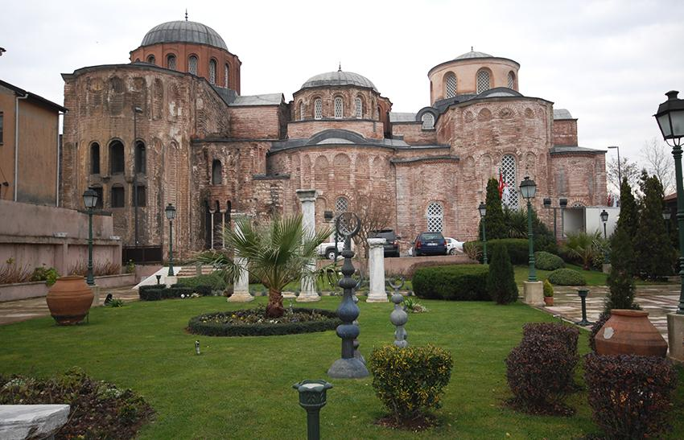
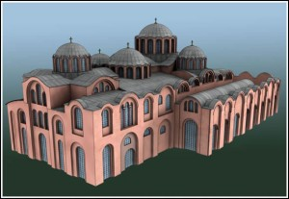
Zeyrek Mosque
Or Pantokrator Monastery (in Turkish: Pantokrator Manastırı)
Significant mosque in Istanbul
Made of two former Eastern Orthodox churches and a chapel
Typical example of architecture of the Byzantine middle period in Constantinople
After Hagia Sophia, the second largest religious edifice built by the Byzantines remaining in Istanbul.

Slide 16
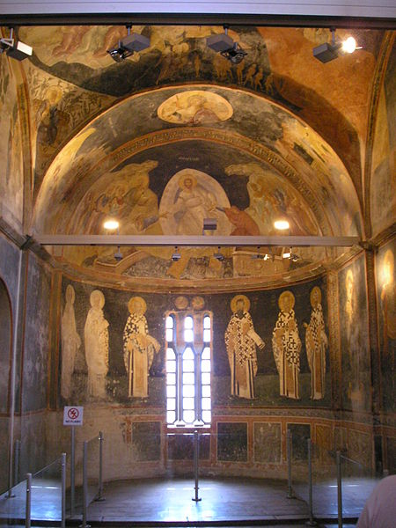
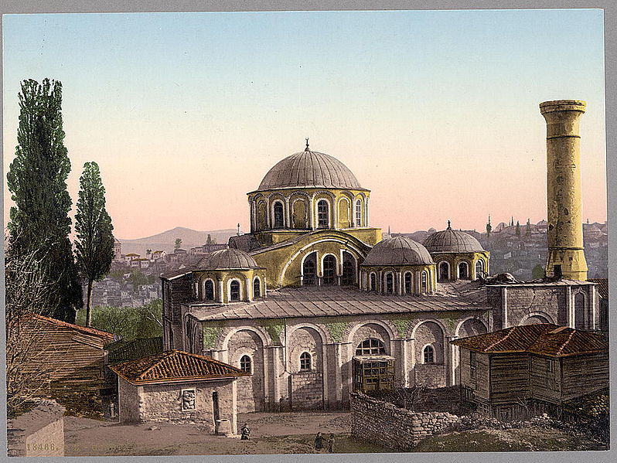
Chora Church
Extremely ancient Byzantine Greek Orthodox church preserved as a museum in the Edirnekapı neighborhood of Istanbul
In the 16th century, during the Ottoman era, the church was converted into a mosque; it became a museum in 1948 (Again)
The interior of the building is covered with some of the oldest and finest surviving Byzantine mosaics and frescoes; they were uncovered and restored after the building was secularized and turned into a museum.

Slide 17
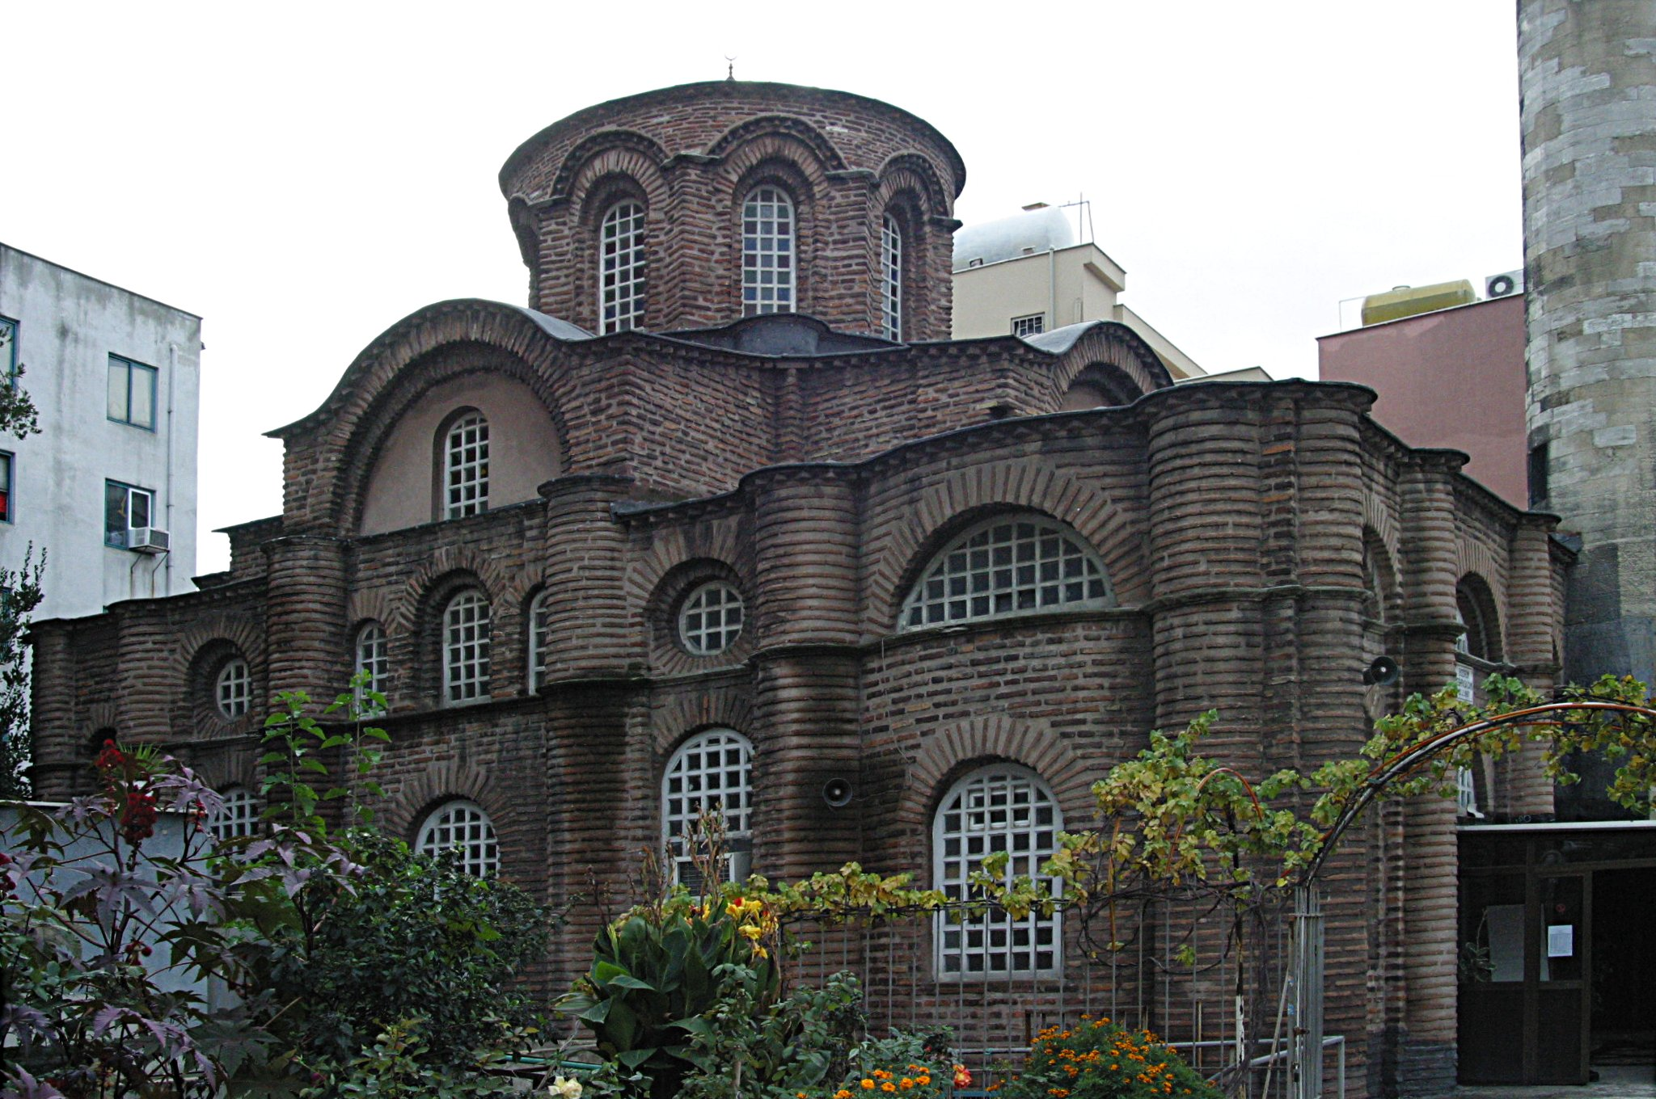
Bodrum Mosque
The palace of Myrelaion was built on top of a giant fifth century rotunda which, with an external diameter of 41.8 meters, was the second largest, after the Roman Pantheon, in the ancient world. In the tenth century the rotunda was not used anymore, and then it was converted - possibly by Romanos himself - into a cistern by covering its interior with a vaulted system carried by at least 70 columns. Near the palace the Emperor built a church, which he intended from the beginning to use as burial place for his family.

