Slide 1
What does our community think about Spain?
A survey related to Spain from TEVİTÖL
(answered by more than 100 students)

Slide 6
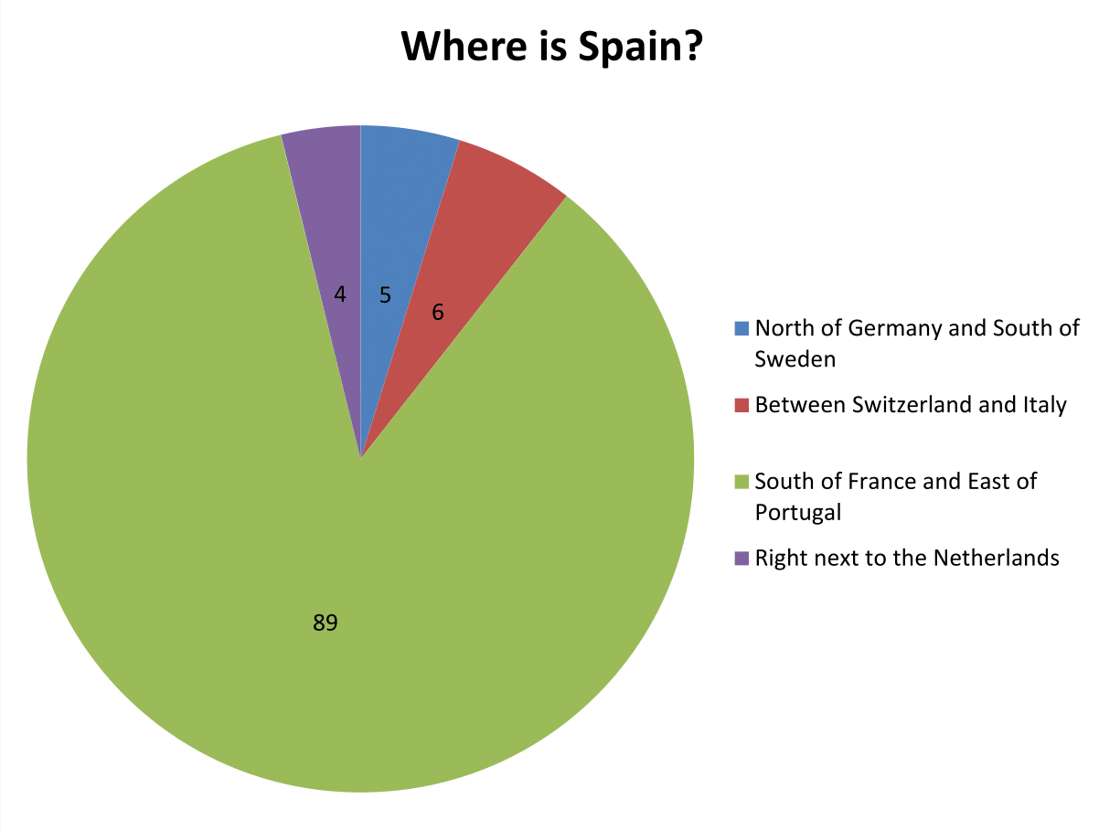

Slide 7
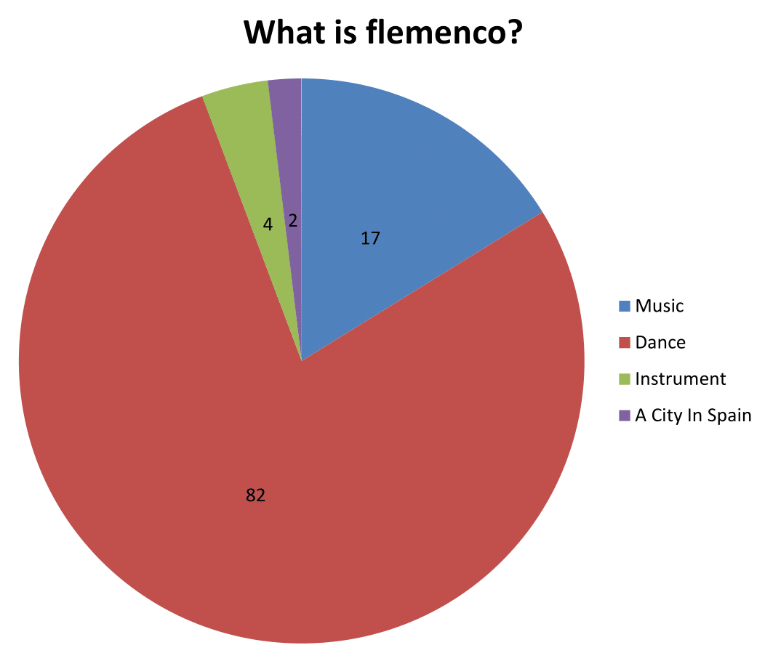

Slide 8
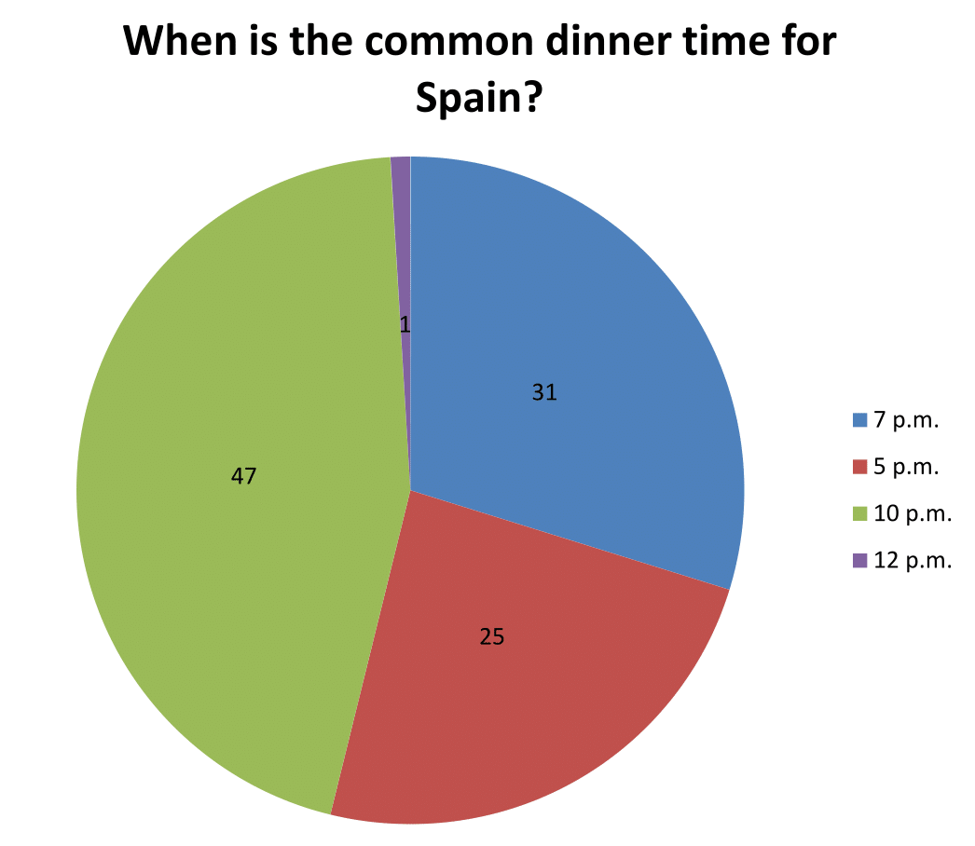

Slide 9
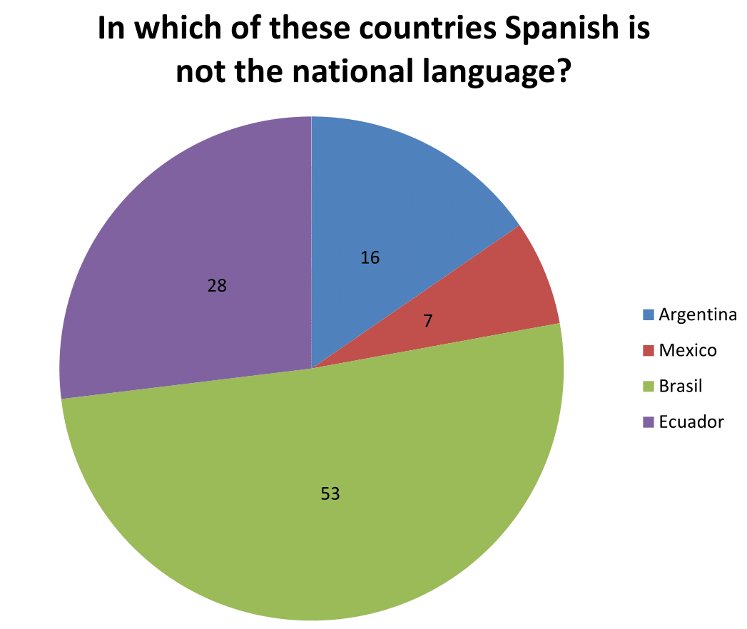

Slide 10
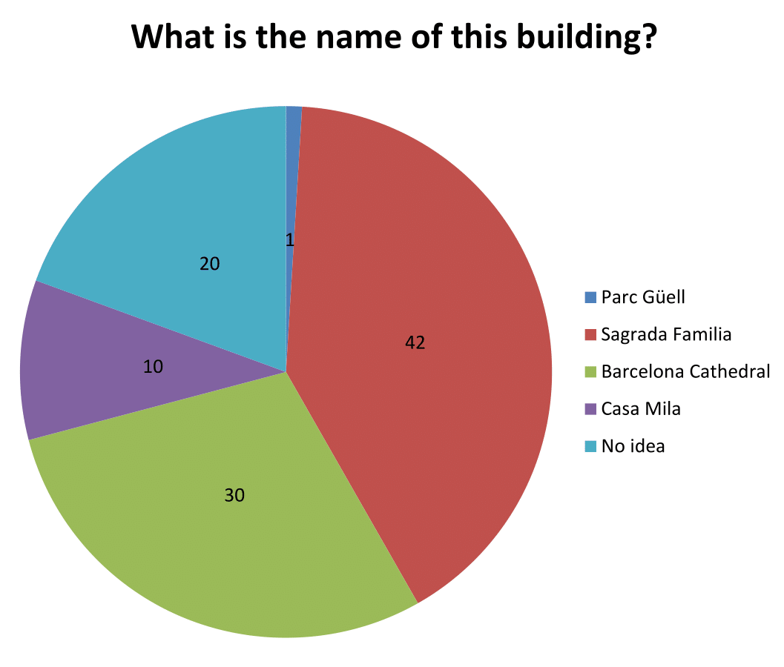

Slide 11
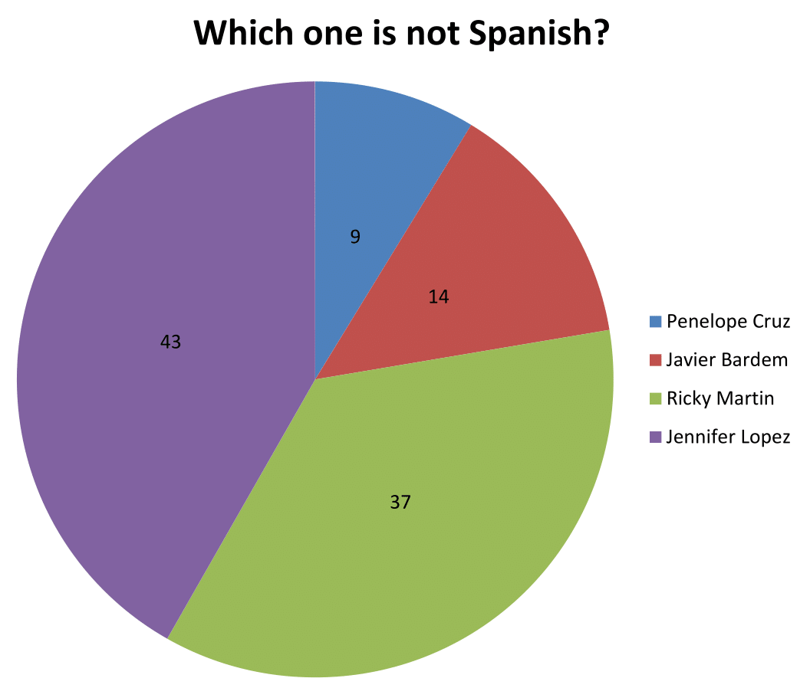

Slide 12
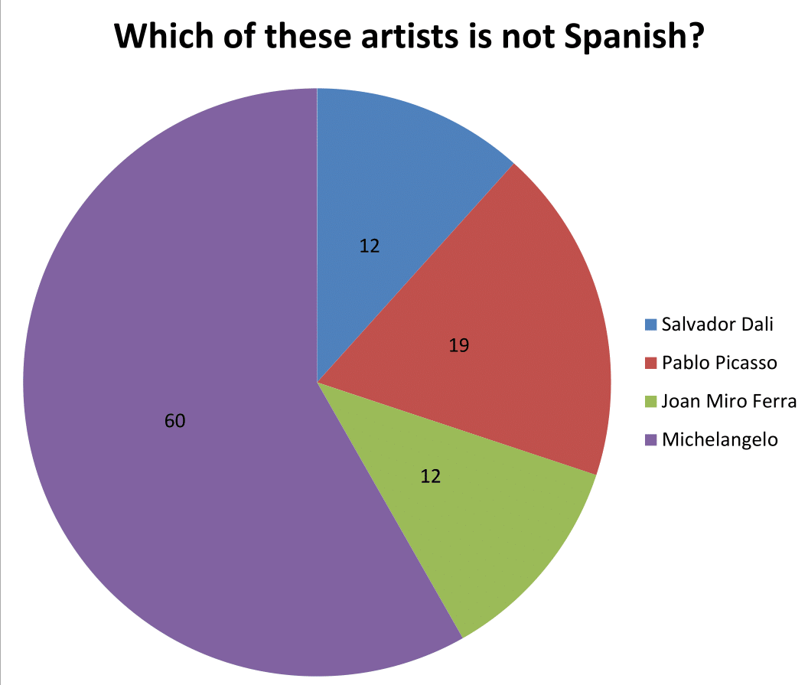

Slide 13
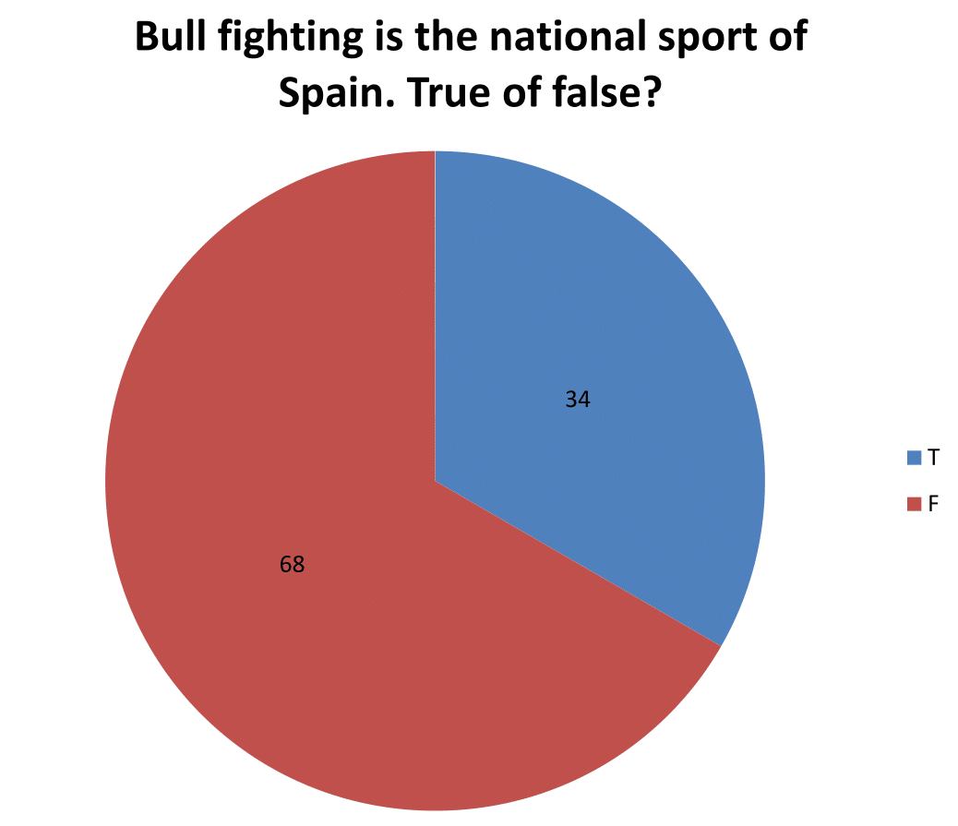

Slide 14
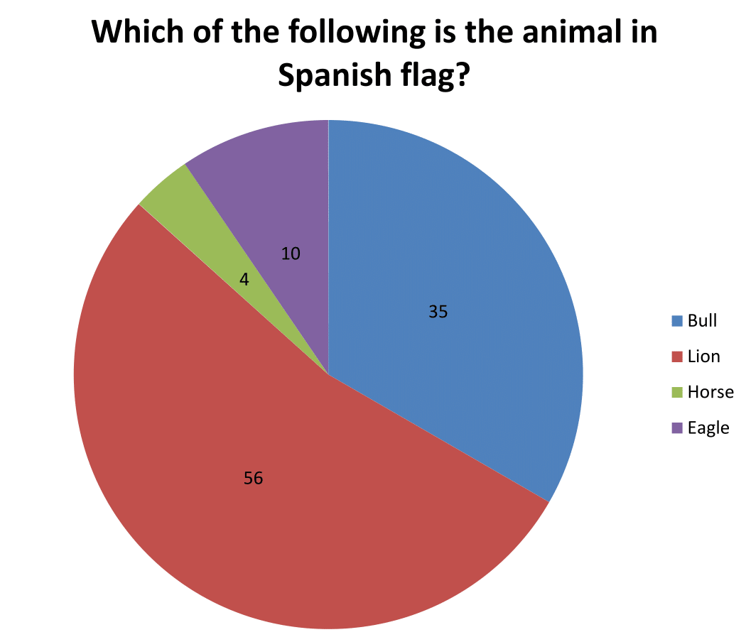

Slide 15
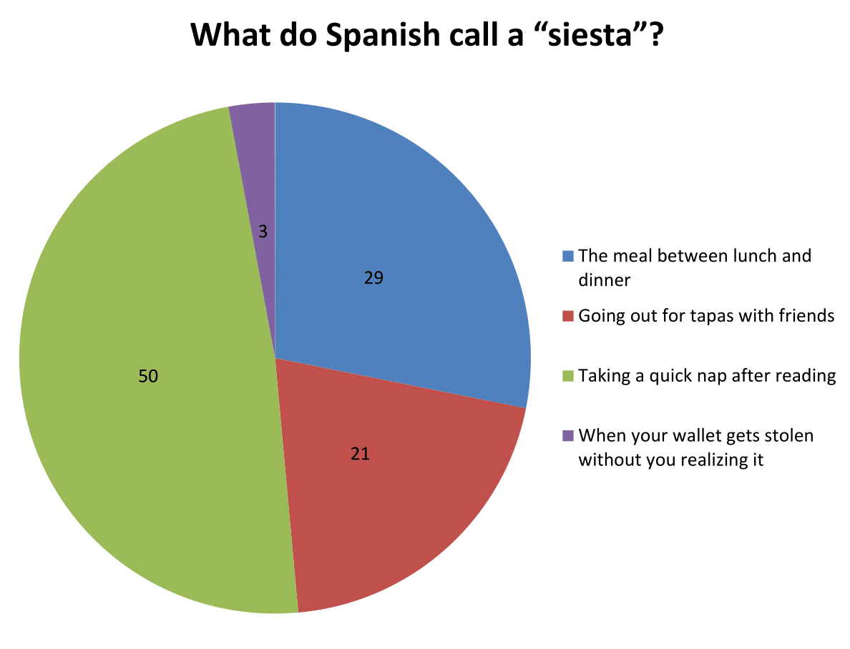

Slide 16
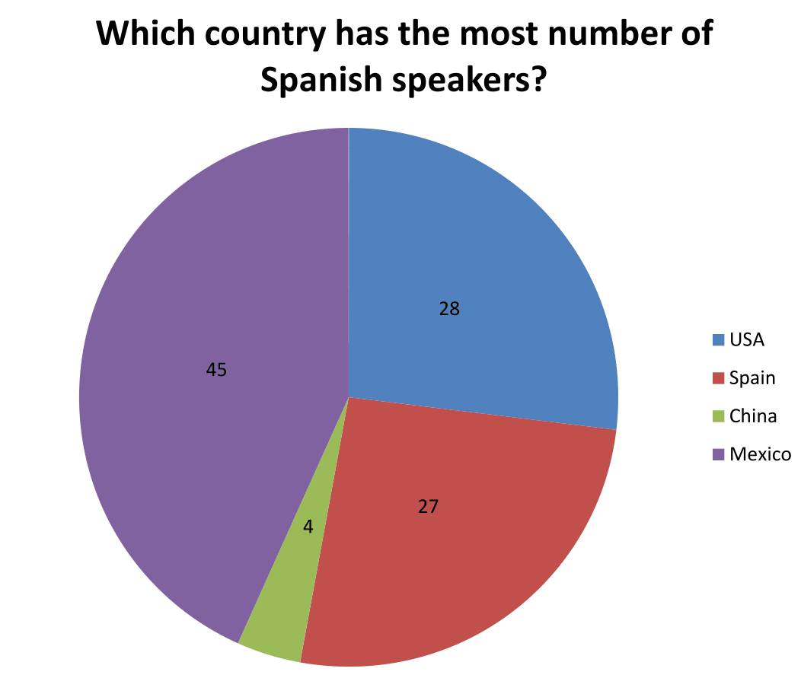

Slide 17
What is the first thing that comes to your mind about Spain?
Bull | Music | Letter ‘r’ | Tapas
Barcelona | Hot | Beach | Amigo
Flamenco & Dance | La Sagrada Familia | Moustache | Guitar
Football | Party | Men | Ibiza
Sleep & Siesta | Matador | Spanish Civil War | Calimocho
Red, yellow | Paella | Anarcho-syndicalism | Jamón
Spanish | Real Madrid | Food

Slide 18
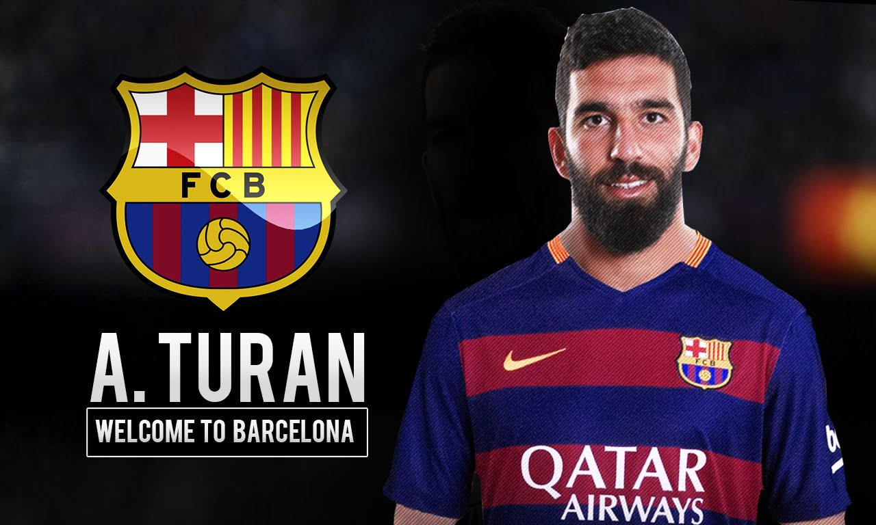
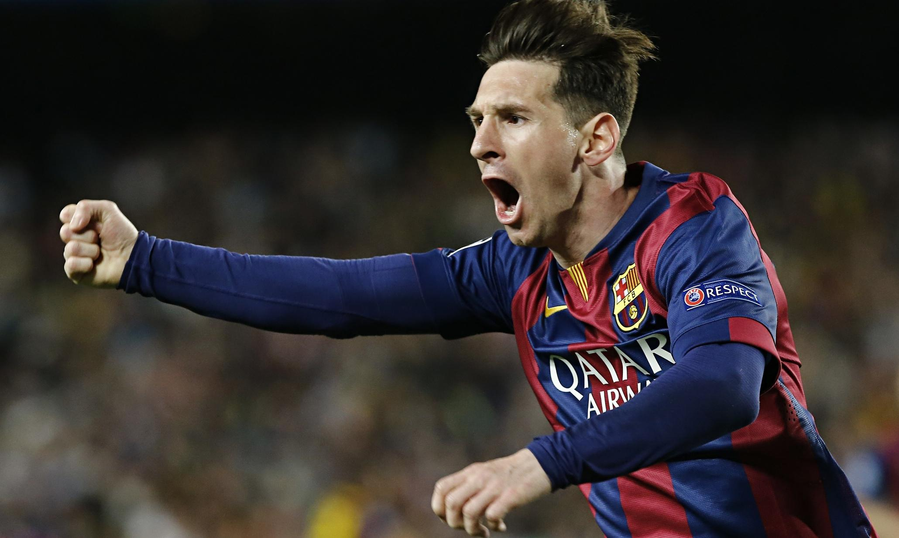
What is the first thing that comes to your mind about Spain?
xPeke | Messi
Rafael Nadal | Andres Iniesta
Mr. Lisi x2 | Don Quixote
Shakira | Paz Vega
Franco | Antoni Gaudí
Arda Turan | Messi
xPeke | Andres Iniesta

Slide 19
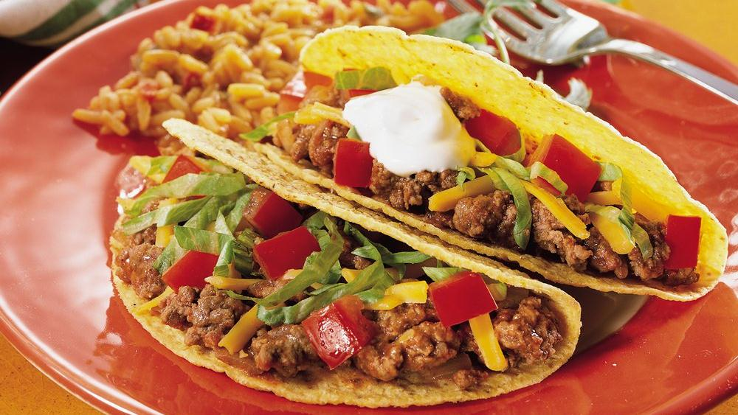
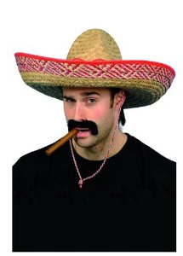
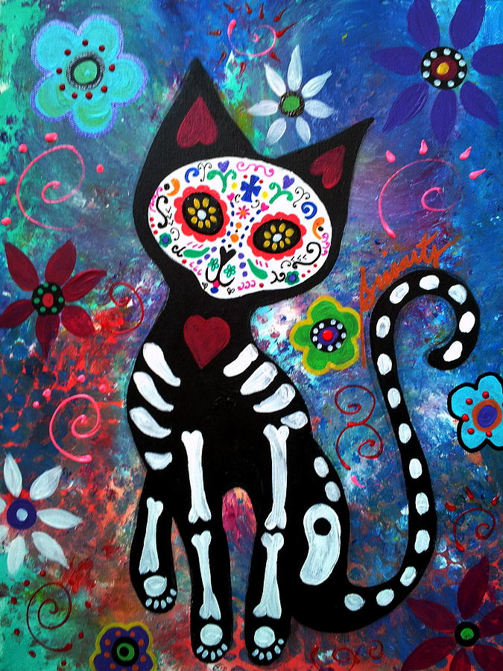
Non-Spanish Stuff
Mexican Hat (Sombrero)
Cactus
Chilli Pepper
Day of Dead
Taco
Mayans
Italy

Slide 20
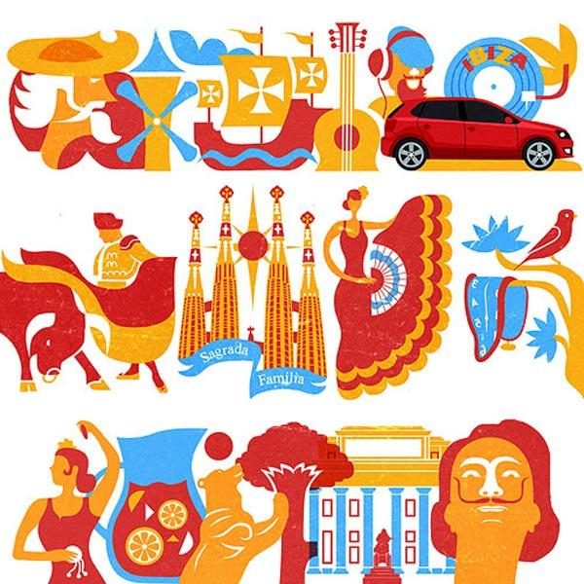
Barkın Şimşek
Ekin Balcı
Yağmur Ünal
Esra Yaman
Selin Arpacı
Berfin Karaman
Azmi Ozan Ateş
Kendal Varolgüneş
Ezgi Karayel
Baran İşcanlı

